Slide 1
Where do we start?

Slide 2
Lessons from how we started

Slide 3
What is ECO action?
Mission
We engage with and help local people to take action on biodiversity loss and climate change, through activities, events, advice and partnerships, for the benefit of our whole community and our planet.
Reduce Carbon
Increase Nature
Boost Wellbeing

Slide 4
What is ECO action?
Mission
We engage with and help local people to take action on biodiversity loss and climate change, through activities, events, advice and partnerships, for the benefit of our whole community and our planet.’
Reduce Carbon
Increase Nature
Boost Wellbeing

Slide 5
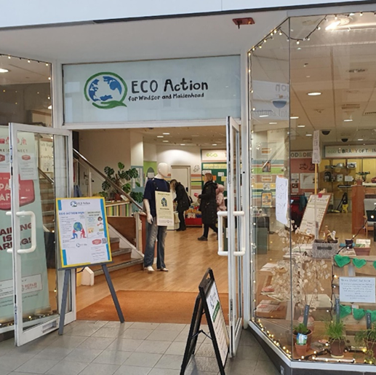
ECO Action Hub Journey
Started in January 2022
Have learned a lot!
Talk about:
Initial consultations
What we wanted to do
Initial plan
Action
Six month review
Where are we now.
Reduce Carbon
Increase Nature
Boost Wellbeing

Slide 6
Discussion: Who are you?
Who are you?
Do you know what you want to do?
In how much detail?
Who are your stakeholders?
Reduce Carbon
Increase Nature
Boost Wellbeing

Slide 7
Consultations with stakeholders
What does this mean?
ECO Action’s stakeholders were:
21 initial potential partners
People who live or work in RBWM
ECO Action initially:
Met with 17 out of 21 potential partners on Jan 20th 2022
Carried out a survey of residents opinions
Do not expect a complete consensus!
Balance your vision with messages from consultation
The more you are innovating, the less your stakeholders will understand
Steve Jobs – vision for iPod
Reduce Carbon
Increase Nature
Boost Wellbeing

Slide 8
Reduce Carbon
Increase Nature
Boost Wellbeing

Slide 9
Discussion: Stakeholder consultations
Who are your stakeholders?
How do you reach them?
Are they on your side and do they share your priorities?
How do you balance your vision with their inputs?
Reduce Carbon
Increase Nature
Boost Wellbeing

Slide 10
You have decided what to do and have some supporters – what next?
Practical advice on:
Do you need a (new to you) physical space?
Mobilising volunteer help
How do you raise initial funding
How do you ensure sustainability

Slide 11
ECO Action’s Hub
Trial, six week, pop-ups in April 2022 and November 2022
‘Foundation stone’ meeting in November 2022
Keys to 5/7 Nicholson’s Centre 7th January 2023
4000 volunteer hours input in less that four months
Opened on 1st April 2023
5 year ‘meanwhile’ lease
One month’s notice by either party
Total cost of rates, service charges and rent is 1 peppercorn per year
Utilities costs supported by RBWM
Six month review.
Stop pushing our messages out
Offer to help everyone with their priorities – saving money and addressing their climate trauma.
Reduce Carbon
Increase Nature
Boost Wellbeing

Slide 12
Our volunteers
15 core members of team
60+ occasional volunteers
Need to be kept busy
Need good social media to keep them involved
Give them specific tasks.
Reduce Carbon
Increase Nature
Boost Wellbeing

Slide 13
Initial funding
Grants are readily available for initiatives and start up activities. ECO Action has received funding from:
Green skills library
Capital and Kidwell Trust
Baylis Trust
Transition Town
ECO fund
Prince Phillip Trust
Filling Good
The Climate Partnership*
* The Climate Partnership gives a very high priority to (part) funding start up activities on the Circular Economy, Energy, Natural Environment and Transport.
Reduce Carbon
Increase Nature
Boost Wellbeing

Slide 14
Sustainable funding
Much more difficult than start up funding!
ECO Action has committed monthly funding of £1050 from a few individual subscribers.
Charitable status will help
- Gift aid increase of 25%
- Subscribers are tempted by a bargain.
Our target is to broaden this base substantially by the end of this financial year.
Monthly subscriptions are the core of many organisations, e. g:
Places of worship
Public facing charities such as RNLI, etc.
Reduce Carbon
Increase Nature
Boost Wellbeing

Slide 15
Discussion: Getting started
Do you need physical space?
Have you identified it?
Where will your volunteers come from?
How do you motivate them?
What start up funding will you need?
Which organisations will you approach?
Do you need on-going funding?
How to make a subscription model work?
Should it be voluntary?
Reduce Carbon
Increase Nature
Boost Wellbeing

Slide 16
Conclusions
ECO Action would be pleased to help you!
Just get started- it is immensely rewarding and very important for the future of our wonderful world and the well-being of future generations.
Good luck on your journey!
Reduce Carbon
Increase Nature
Boost Wellbeing

Slide 17
Understanding and striving
for a Circular Economy
(within our influence)
Dave Scarbrough
Notes:
11 slides * 2 mins each + 2 mins extra for CE Model slide 20 mins
1 video 5 mins
Slide 7 – Individually Linear model examples 5 mins
Slide 8 - In tables: Ask people to write on their CE Model each of the R’s
Ask people to write on their CE Model each of ECO Action & Partners services 10 mins
Slide 10 - In Tables: Add to relevant Good/bad ideas on to the CE Model 10 mins
Slide 12 - Individually: suggest note some ideas for them and for their community/group 10 mins
60 mins

Slide 18
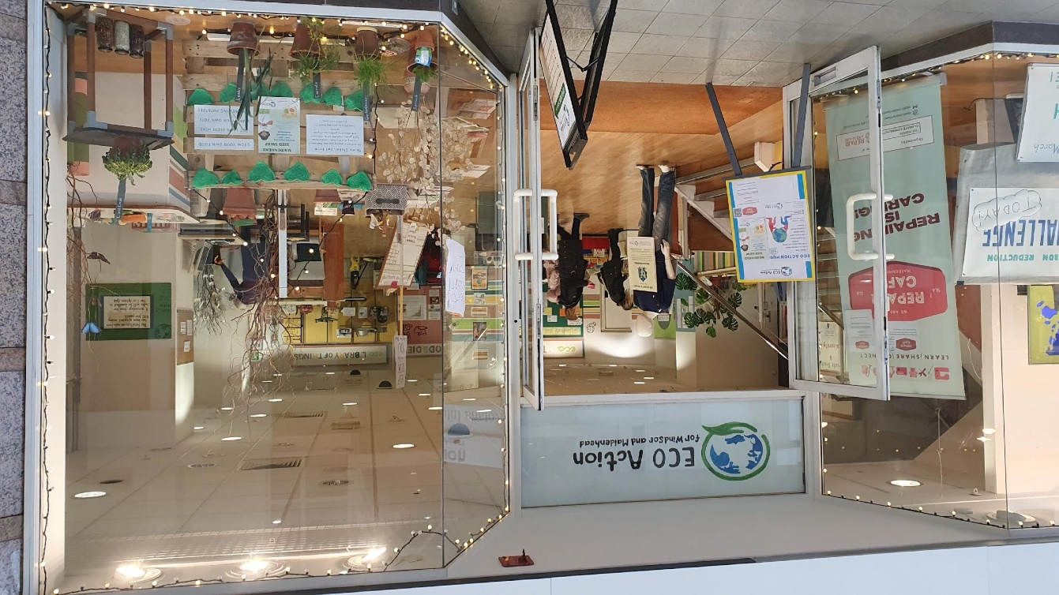
What is ECO Action WAM?
By the Community
For the Community
Inspire and Help people to do a bit more for the planet
Physical Hub in Nicholsons Centre, Maidenhead
Services & Events in the Hub.
Partners throughout RBWM
www.ecoactionhub.co.uk
Reduce Carbon
Increase Nature
Boost Wellbeing!

Slide 19
Understanding and striving for a Circular Economy (within our influence)
Agenda
What Product Lifecycle do we have now?
What is the Circular Economy?
Understanding the Circular Economy
Develop your Personal/Community Group Action Plan
Reduce Carbon
Increase Nature
Boost Wellbeing
Notes:
Ask everyone what they understand about the CE
Write it down

Slide 20
What is the typical Product Lifecycle now?
Think and note some Linear Economy examples:
Your work?
Your Community?
Packaging used/not needed in online deliveries
When you buy do you think about repairability?
How much waste do you/your community generate?
How many of your clothes are mixed materials e.g. polycotton?
Do you live near your work/shops/open space/entertainment?
Where in world does your bought food come from?
How much single-use-plastic do you use in a week?
How many short car journeys do you make?
What is the your energy bill v your neighbours?
Can you generate your own electricity? Grow your own?
Reduce Carbon
Increase Nature
Boost Wellbeing
Notes:
Ask people to think and note down
5 mins work alone

Slide 21
Circular Economy Explained
Notes:
Only have time for 1 video and the Wikipedia is the simplest explanation I have found
I do recommend the Ellen Macarthur foundation video though

Slide 22
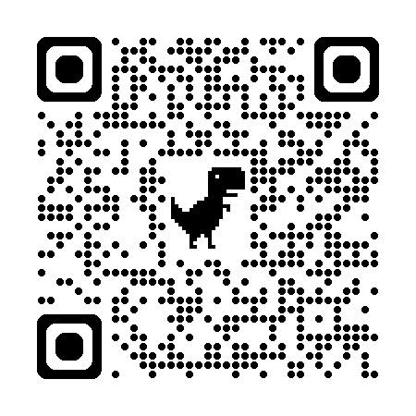
Circular Economy Explained
I recommend that you watch this for more detail
https://www.youtube.com/watch?v=NBEvJwTxs4w
Ellen Macarthur Foundation 9.5 minutes
Reduce Carbon
Increase Nature
Boost Wellbeing
Notes:
Only have time for 1 video and the Wikipedia is the simplest explanation I have found
I do recommend the Ellen Macarthur foundation video though

Slide 23
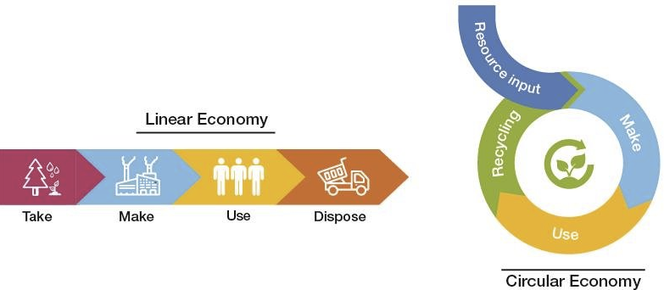
How can we make the Linear Economy more Circular?
Reduce Carbon
Increase Nature
Boost Wellbeing

Slide 24
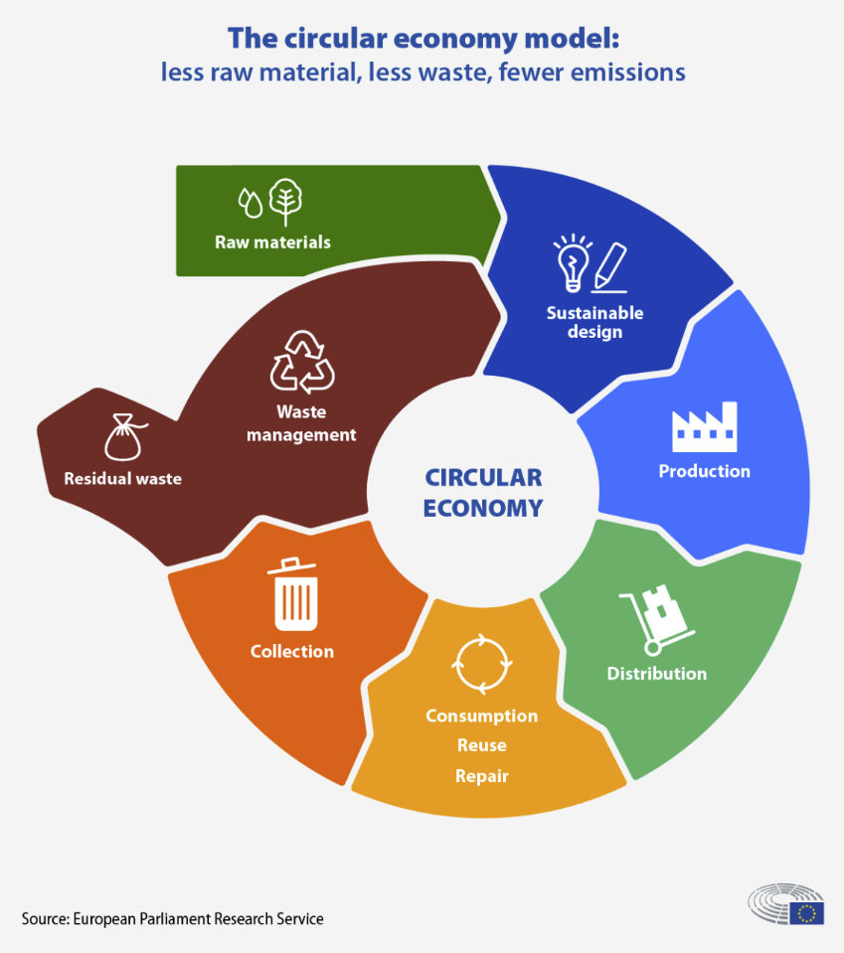
Circular Economy model & Principles
Driven by design
3 Regenerate nature
1 Eliminate waste and pollution
Underpinned by a transition to renewable energy and materials.
Source Ellen Macarthur Foundation
2 Circulate products and materials at their highest value
Reduce Carbon
Increase Nature
Boost Wellbeing
Notes:
Spend time on this slide
Hopefully have an A3 or A2 printed sheet of the model for each table
End of this slide say it is difficult to understand so now want to help you to better understand and how you and your community can do more
1 Eliminate waste and pollution
Currently, our economy works in a linear take-make-waste system. We take raw materials from the Earth, we make products and eventually we throw them away. But, the planet’s resources are finite…
2 Circulate products and materials at their highest value
This means keeping materials in use, either as a product or, when that can no longer be used, as components or raw materials. This way, nothing becomes waste and the intrinsic value of products and materials are retained.
3 Regenerate nature ((Reduce extraction of elements,
By shifting our economy from linear to circular, we shift the focus from extraction to regeneration. Instead of continuously degrading nature, we build natural capital. We employ farming practises that allow nature to rebuild soils and increase biodiversity, and return biological materials to the earth. Currently, most of these materials are lost after use and the land used to grow them is depleted of nutrients.
The circular economy is a resilient system that is good for business, people, and the environment.

Slide 25
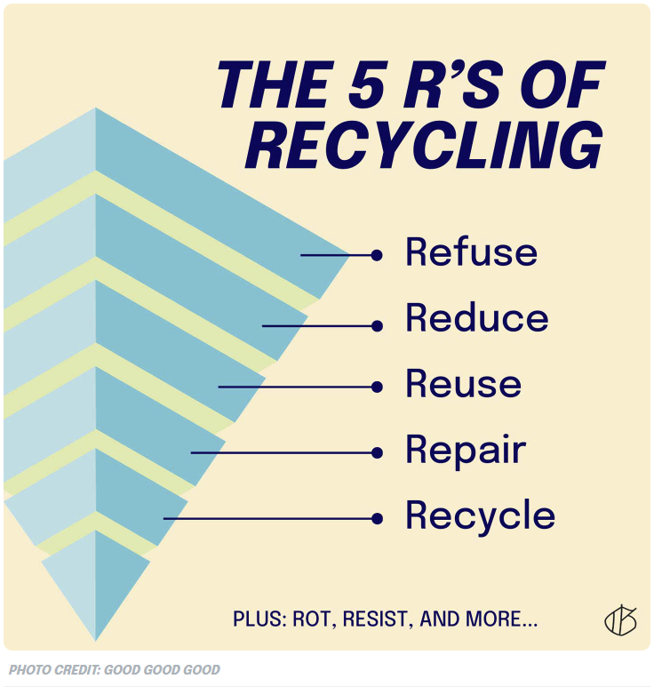
Understanding the Circular Economy:
The R’s Models of Sustainability
ECO Action Partners
Filling Good
MaidEnergy
Cookhams Footprint
SaveEnergy
Cycle Hubs
WAM Active Travel
Plastic Free s
Clean Conscience
The Wilds
Green Earth Plan
Green Skills Library
Waltham Place Farm
Reduce Carbon
Increase Nature
Boost Wellbeing
Notes:
The 3 or 5R’s started as Waste Management
Everyone understands the need to Recycle
As Recycle is at the bottom then you can imagine that this is the least important
These are the services that ECO Action offer to help people to make more of a difference
In tables: Ask people to write on their CE Model each of the R’s
In Tables: Ask people to write on their CE Model each of ECO Action and Partners services and how they can use these services in their community 10 mins

Slide 26
Understanding the Circular Economy: Any examples?
What products demonstrate the Circular Economy?
Which local companies are already doing what they can?
Reduce Carbon
Increase Nature
Boost Wellbeing
Notes:
Ask everyone for good and bad examples
In Tables: Add to relevant Good/bad ideas on to the CE Model 10 mins

Slide 27
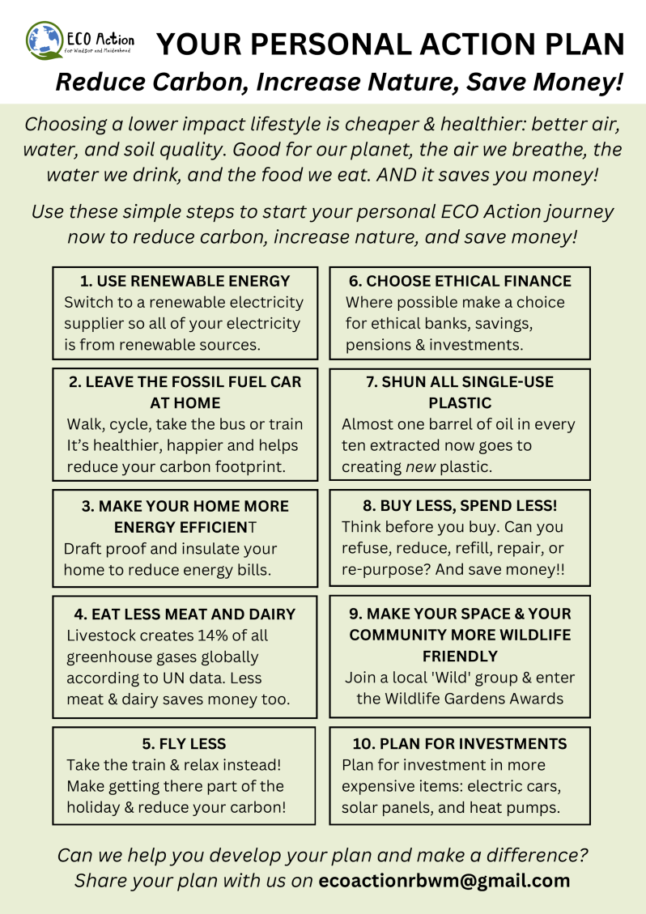
What can you and your community do?
ECO Action recommend taking action at 3 levels
Personal
Examples
How can ‘you’ influence
Sustainable design?
Sustainable distribution?
How can you reduce Residual Waste?
Be more Circular?
Community
Join together as you can make a bigger difference
Use ECO Action services, Partners and Community Space
National
e.g. Lobby your MP to do more for the planet.
e.g. Join a national organisation who is pushing the Government to do more, faster
Always think -
First Refuse, then Reduce, Reuse, Repair, Repurpose, and finally Recycle
Notes:
Hand out our PAP to everyone

Slide 28
Develop your own Personal/Community Group
Action Plan
Notes:
Individually: use the sheet provided 10 mins

Slide 29
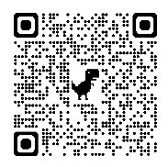
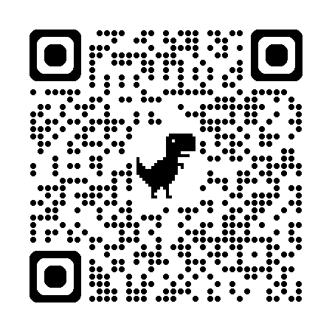
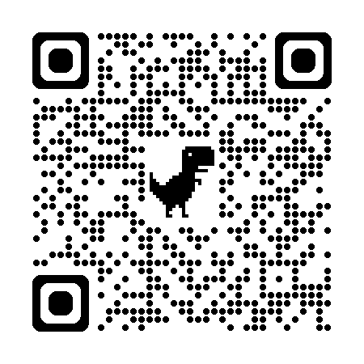
We want to help you save money (and carbon) on your energy bills so please complete our survey
To show us which events you would like.
DraughtBusters! We will save you money by stopping your draughts. Email rbwmdraughtbusters@gmail.com
Greenpeace & The Climate Coalition
“National Day of Action” Saturday 12th October
Come and meet your (Maidenhead) MP in our hub
Borrow items from our
Share-a-LoT
Your local Repair Cafés – Saturdays
Maidenhead 12th Oct 9th Nov 7th Dec
Windsor 19th Oct 23rd Nov
Wraysb.& Horton 26th Oct 30th Nov
Slough 26th Oct 30th Nov
Come to our new Eco Café in our hub

