Slide 1
How are we applying the principles of circular economy in our operations
Climate partnership conference
09.10.2024

Slide 2
AGENDA
Who we are
Basics about Circular economy
What are we doing differently – real life examples
Q&A
Notes:
Please keep your questions for the end – we will have a dedicated session

Slide 3
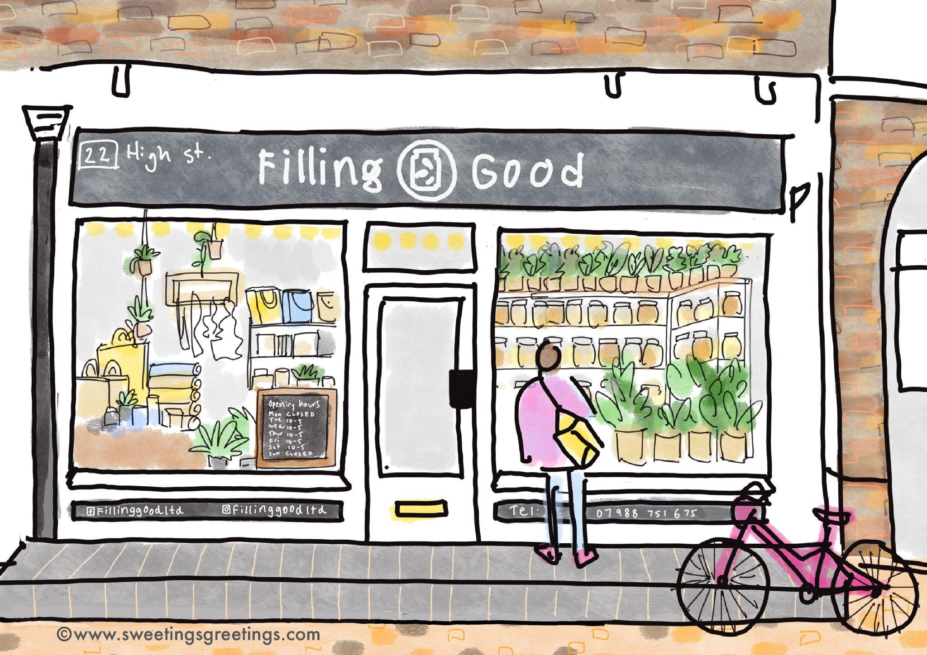
Filling Good in a nutshell
Community owned shop
Refills - zero waste
Not for profit
Run by volunteers
Cooperative
Profit aims to go for Environmental charities
Minimal impact of its operation on the environment
Spread sustainable living
What you need everyday but better
Notes:
There wasn’t a board -

Slide 4
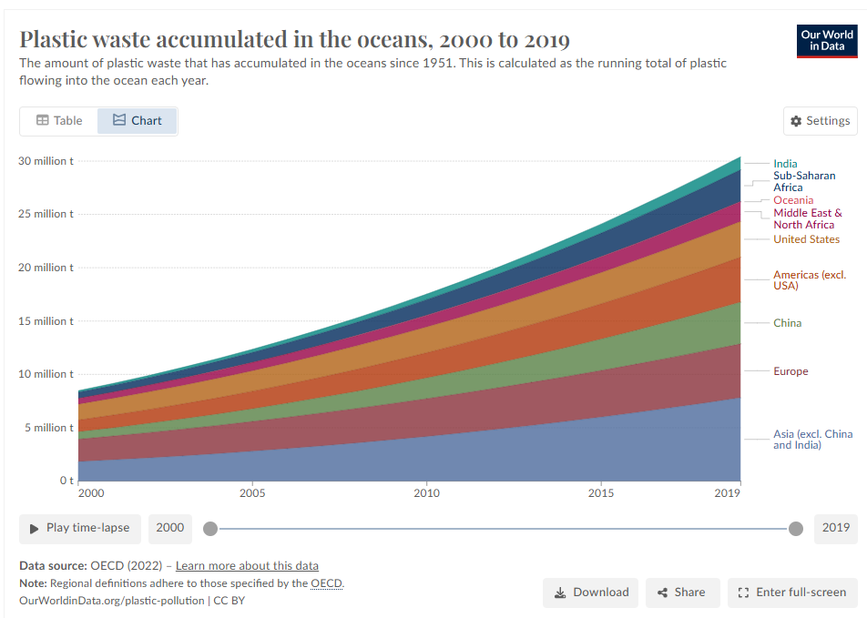
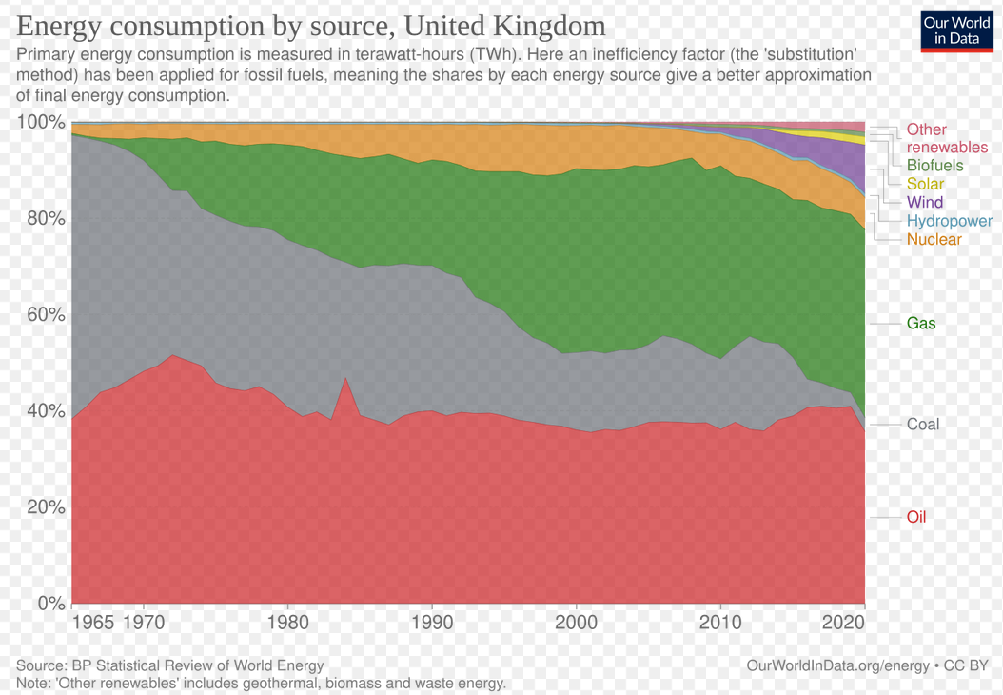
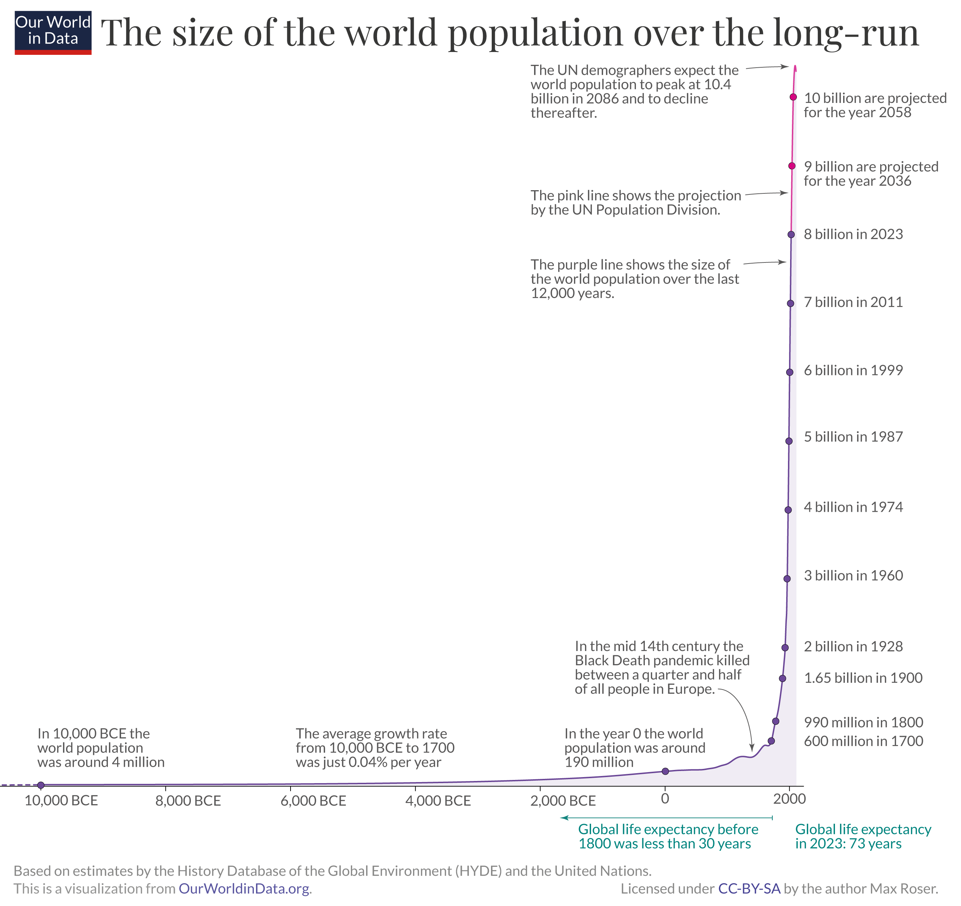
From a linear to a circular economy…
Polluting extraction
Finished resources
Demand is rocketing
Raw materials
Production
Energy use
Transportation
Machines powered by oil = each human being has 200 slaves equivalent in energy (400 in the UK!)
Consumption
Exponential population growth
Higher standard of living than one or two generations before
WASTE
2 billion metric tons worldwide each year
Global recycling waste is… 19%
Notes:
Oil 47years, gas 52years
Phosphorus 100y
PPT - World Raw Material Consumption Trends PowerPoint Presentation, free download - ID:6184851 (slideserve.com)

Slide 5
From a linear to a circular economy…
Linear economy
Reuse economy
Circular economy
Raw materials
Raw materials
Production
Use
Recycling
Production
Production
Recycling
Consumption
Consumption
WASTE
WASTE
… can be only achieved when the whole system switches…
Notes:
Oil 47years, gas 52years
Phosphorus 100y
Quizz : UK energy consumption :

Slide 6
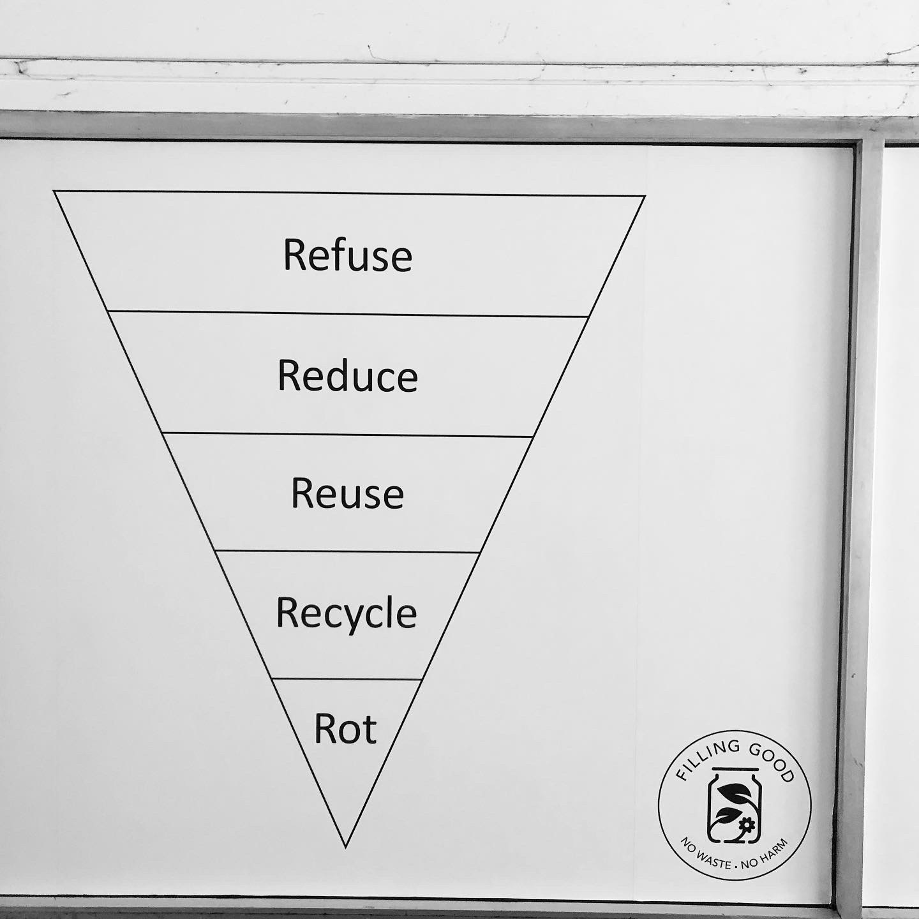
What are we about…
Individual change
Business change
Political change
Notes:
Circular economy for your own household ☺
Only a part of the system

Slide 7
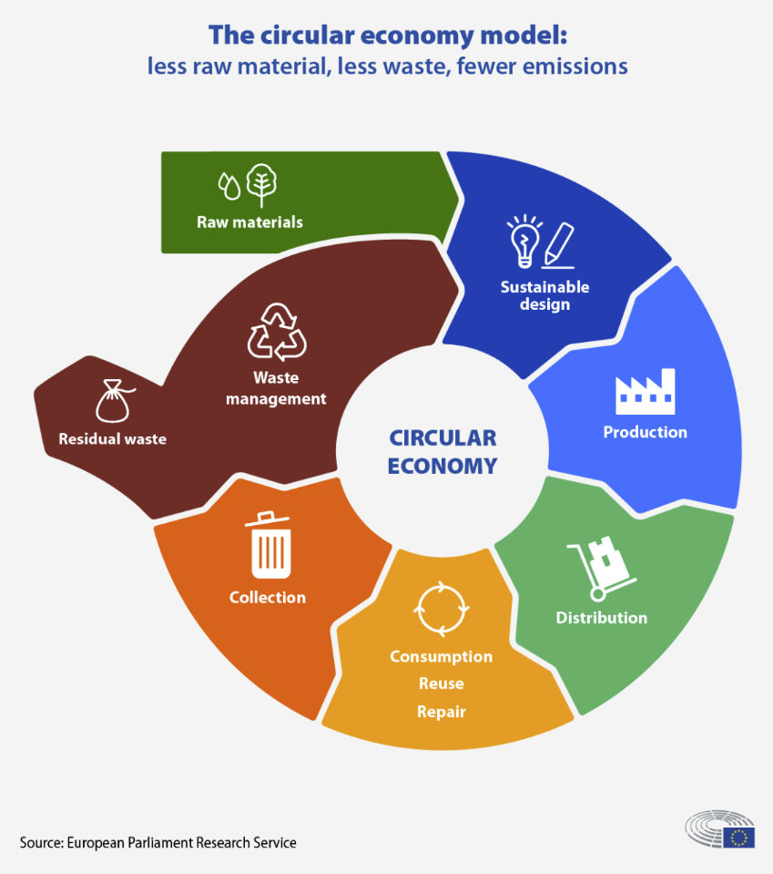
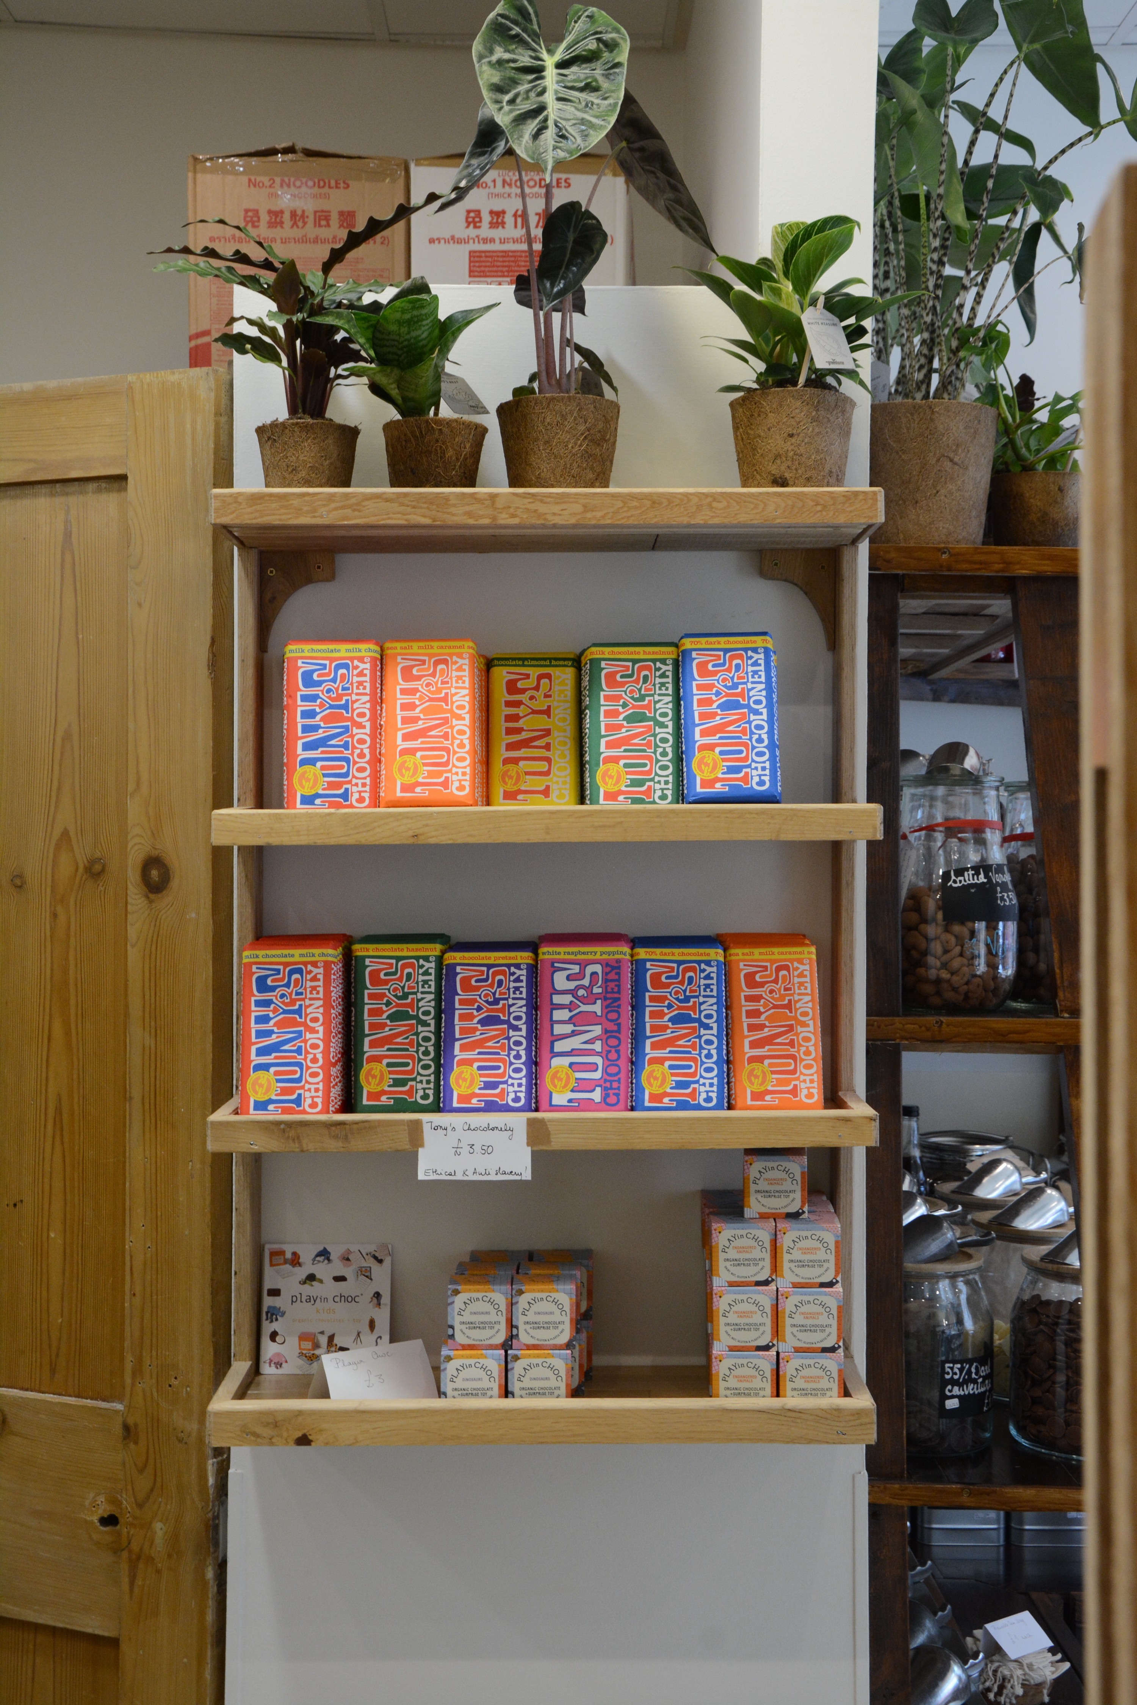
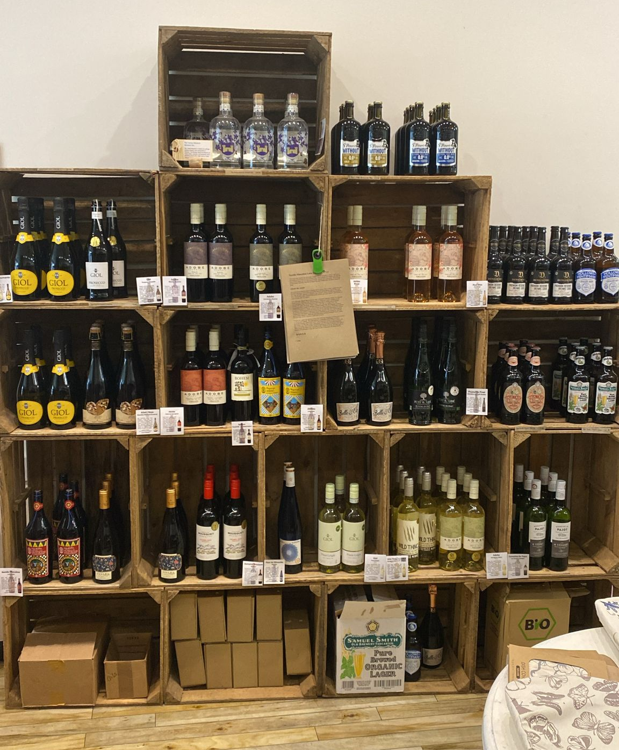
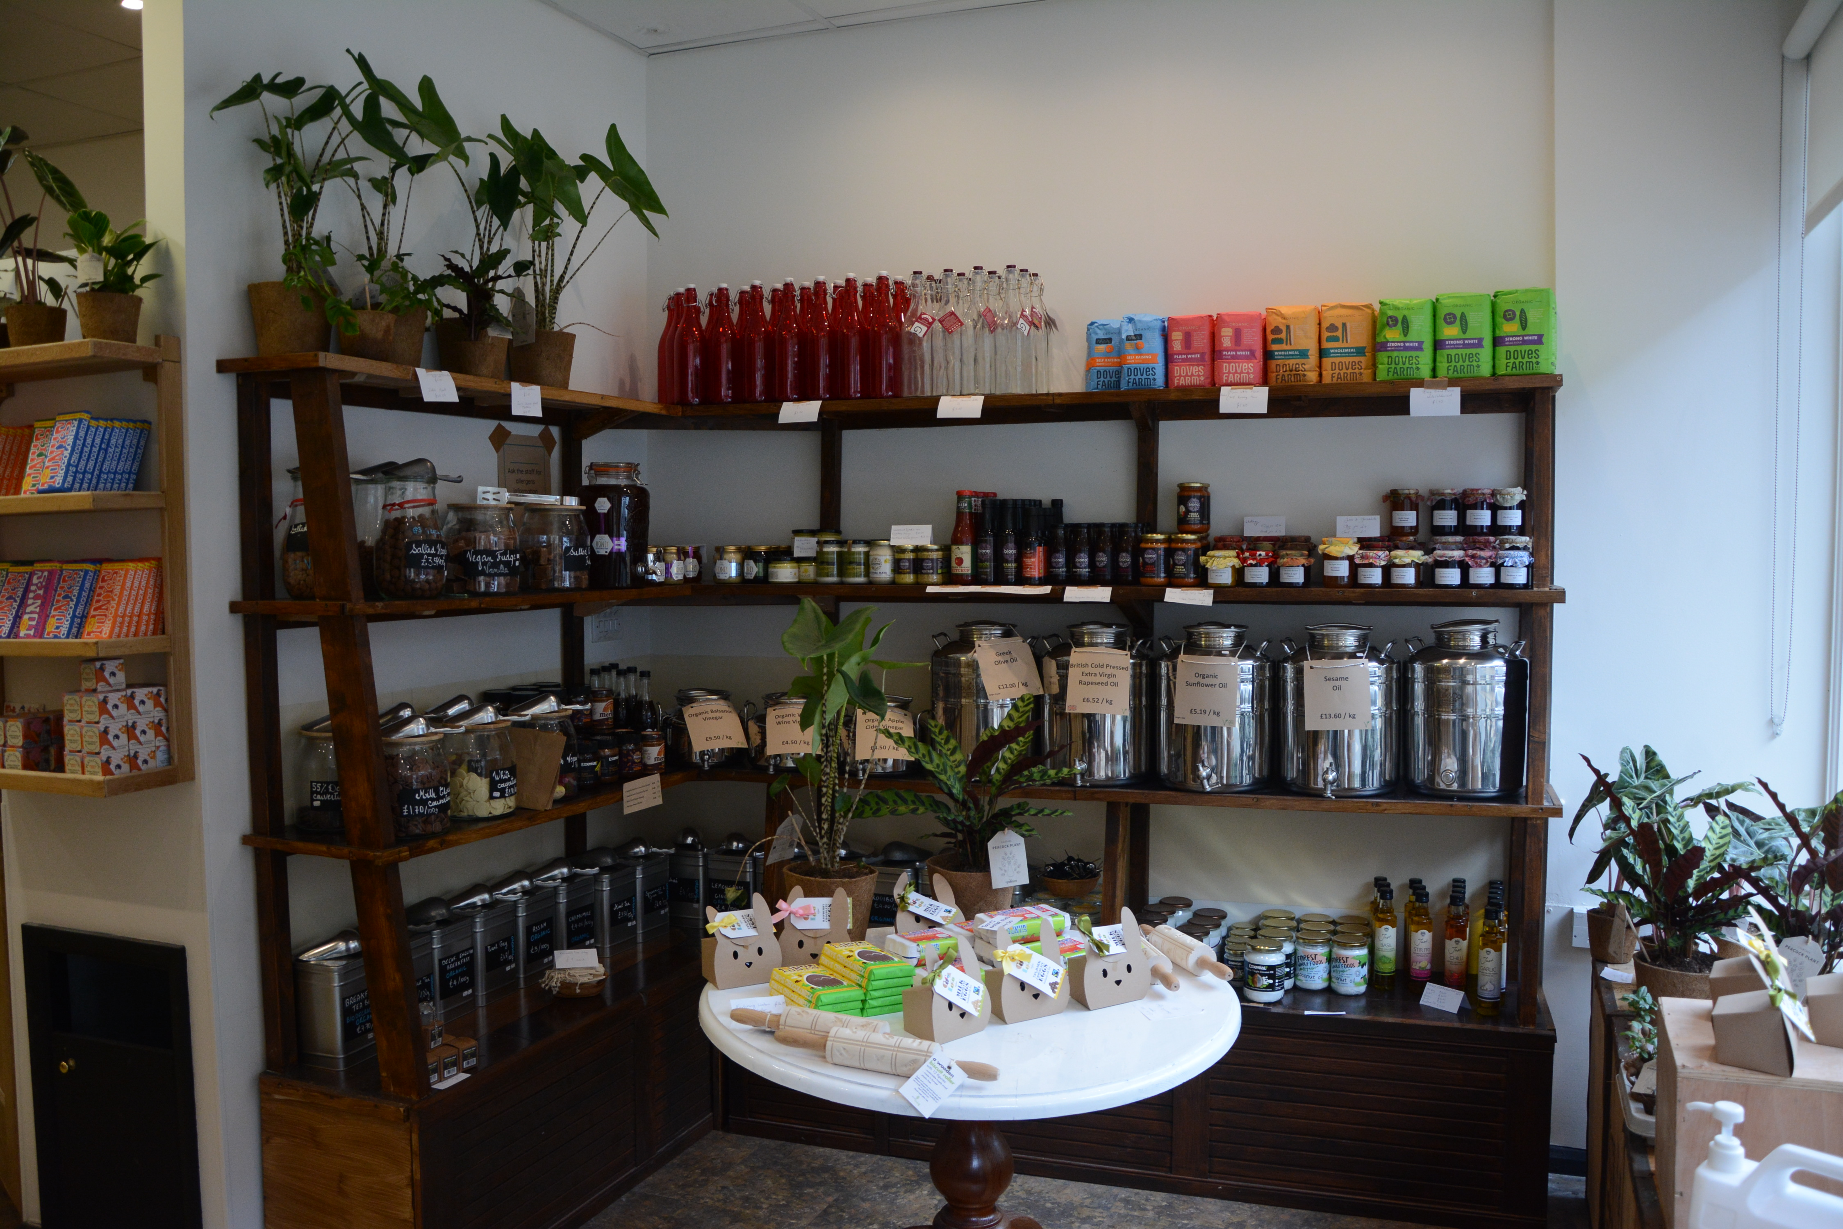
What do we actually do to be as circular as we can?
Furniture and equipment :
Wood used from recycling centre in High Wycombe
Second hand equipment (Ipads, scales, peanut butter machine, cloths, cutlery, mugs, vacuum cleaner…)
Energy : 100% renewable
Products: organic, vegetarian, local where possible, reusable material (ex: cork…)

Slide 8
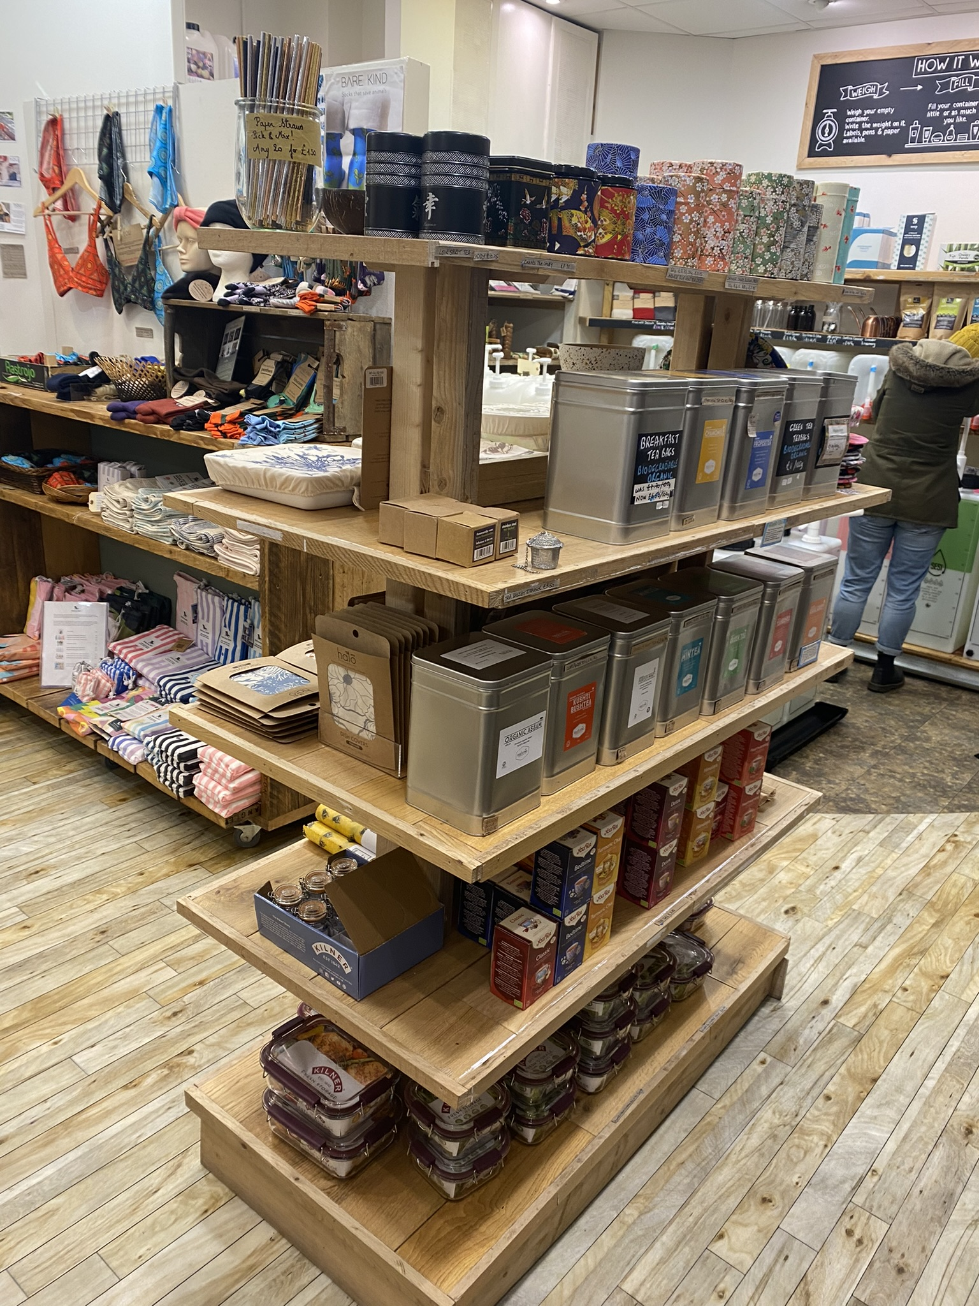
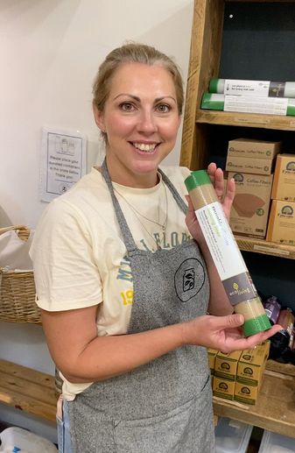
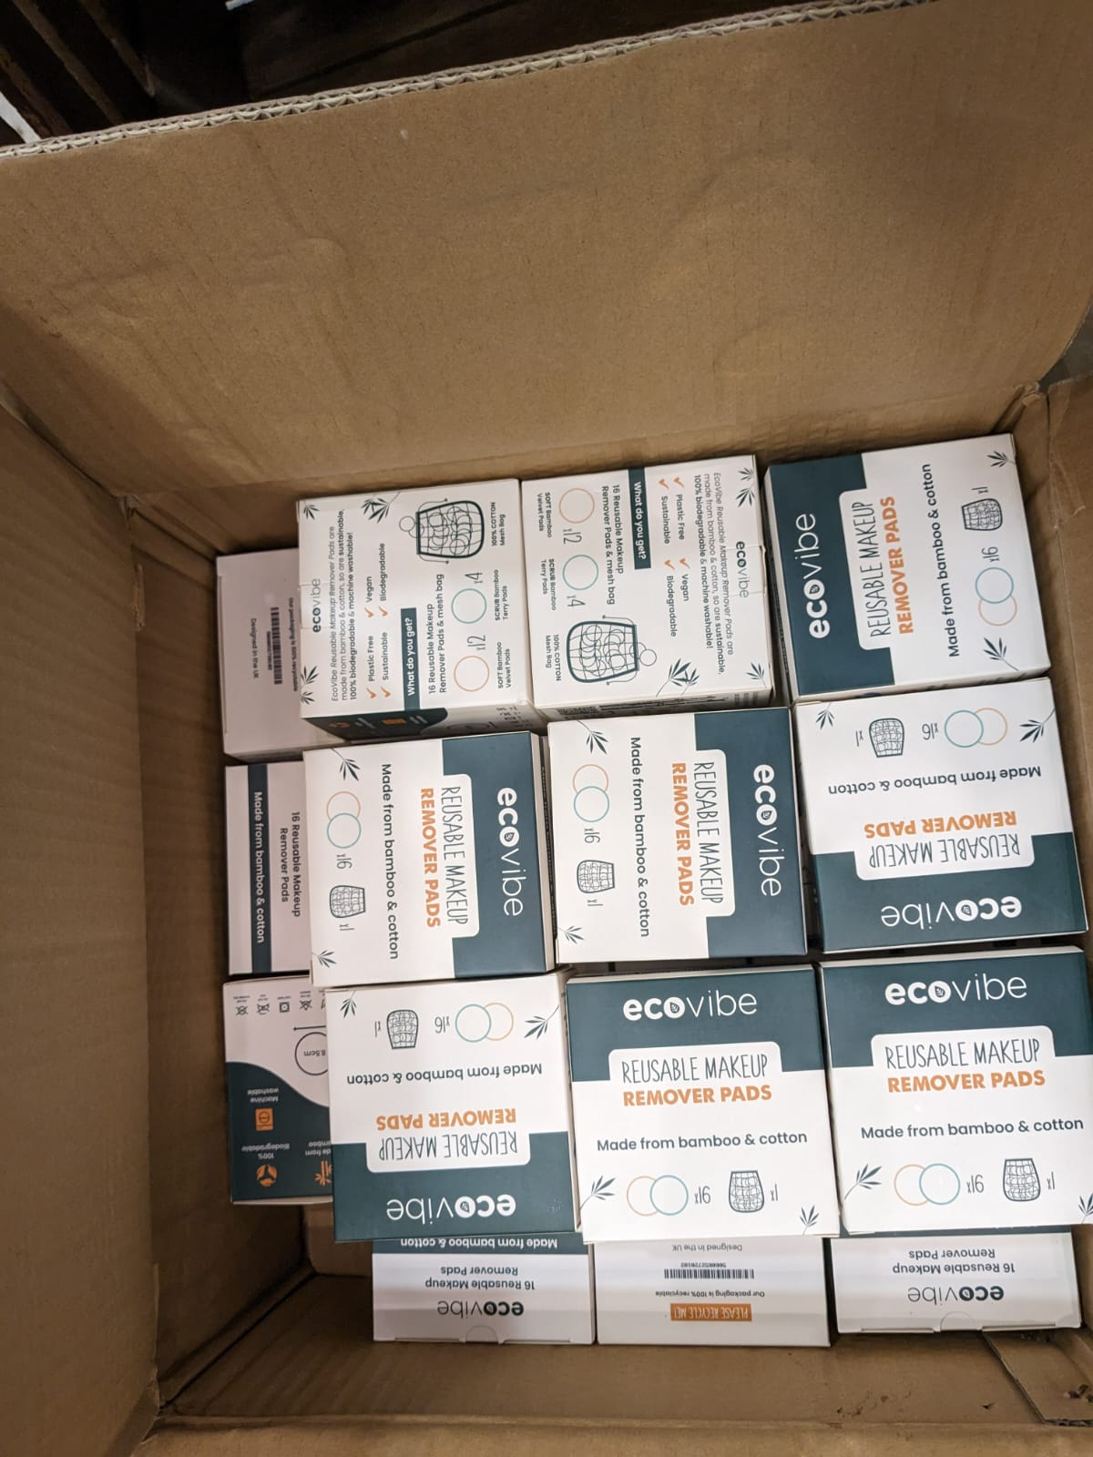
What do we actually do to be as circular as we can?
Furniture modular and reusable by design
Portfolio : many products are reusable for life – by design!

Slide 9
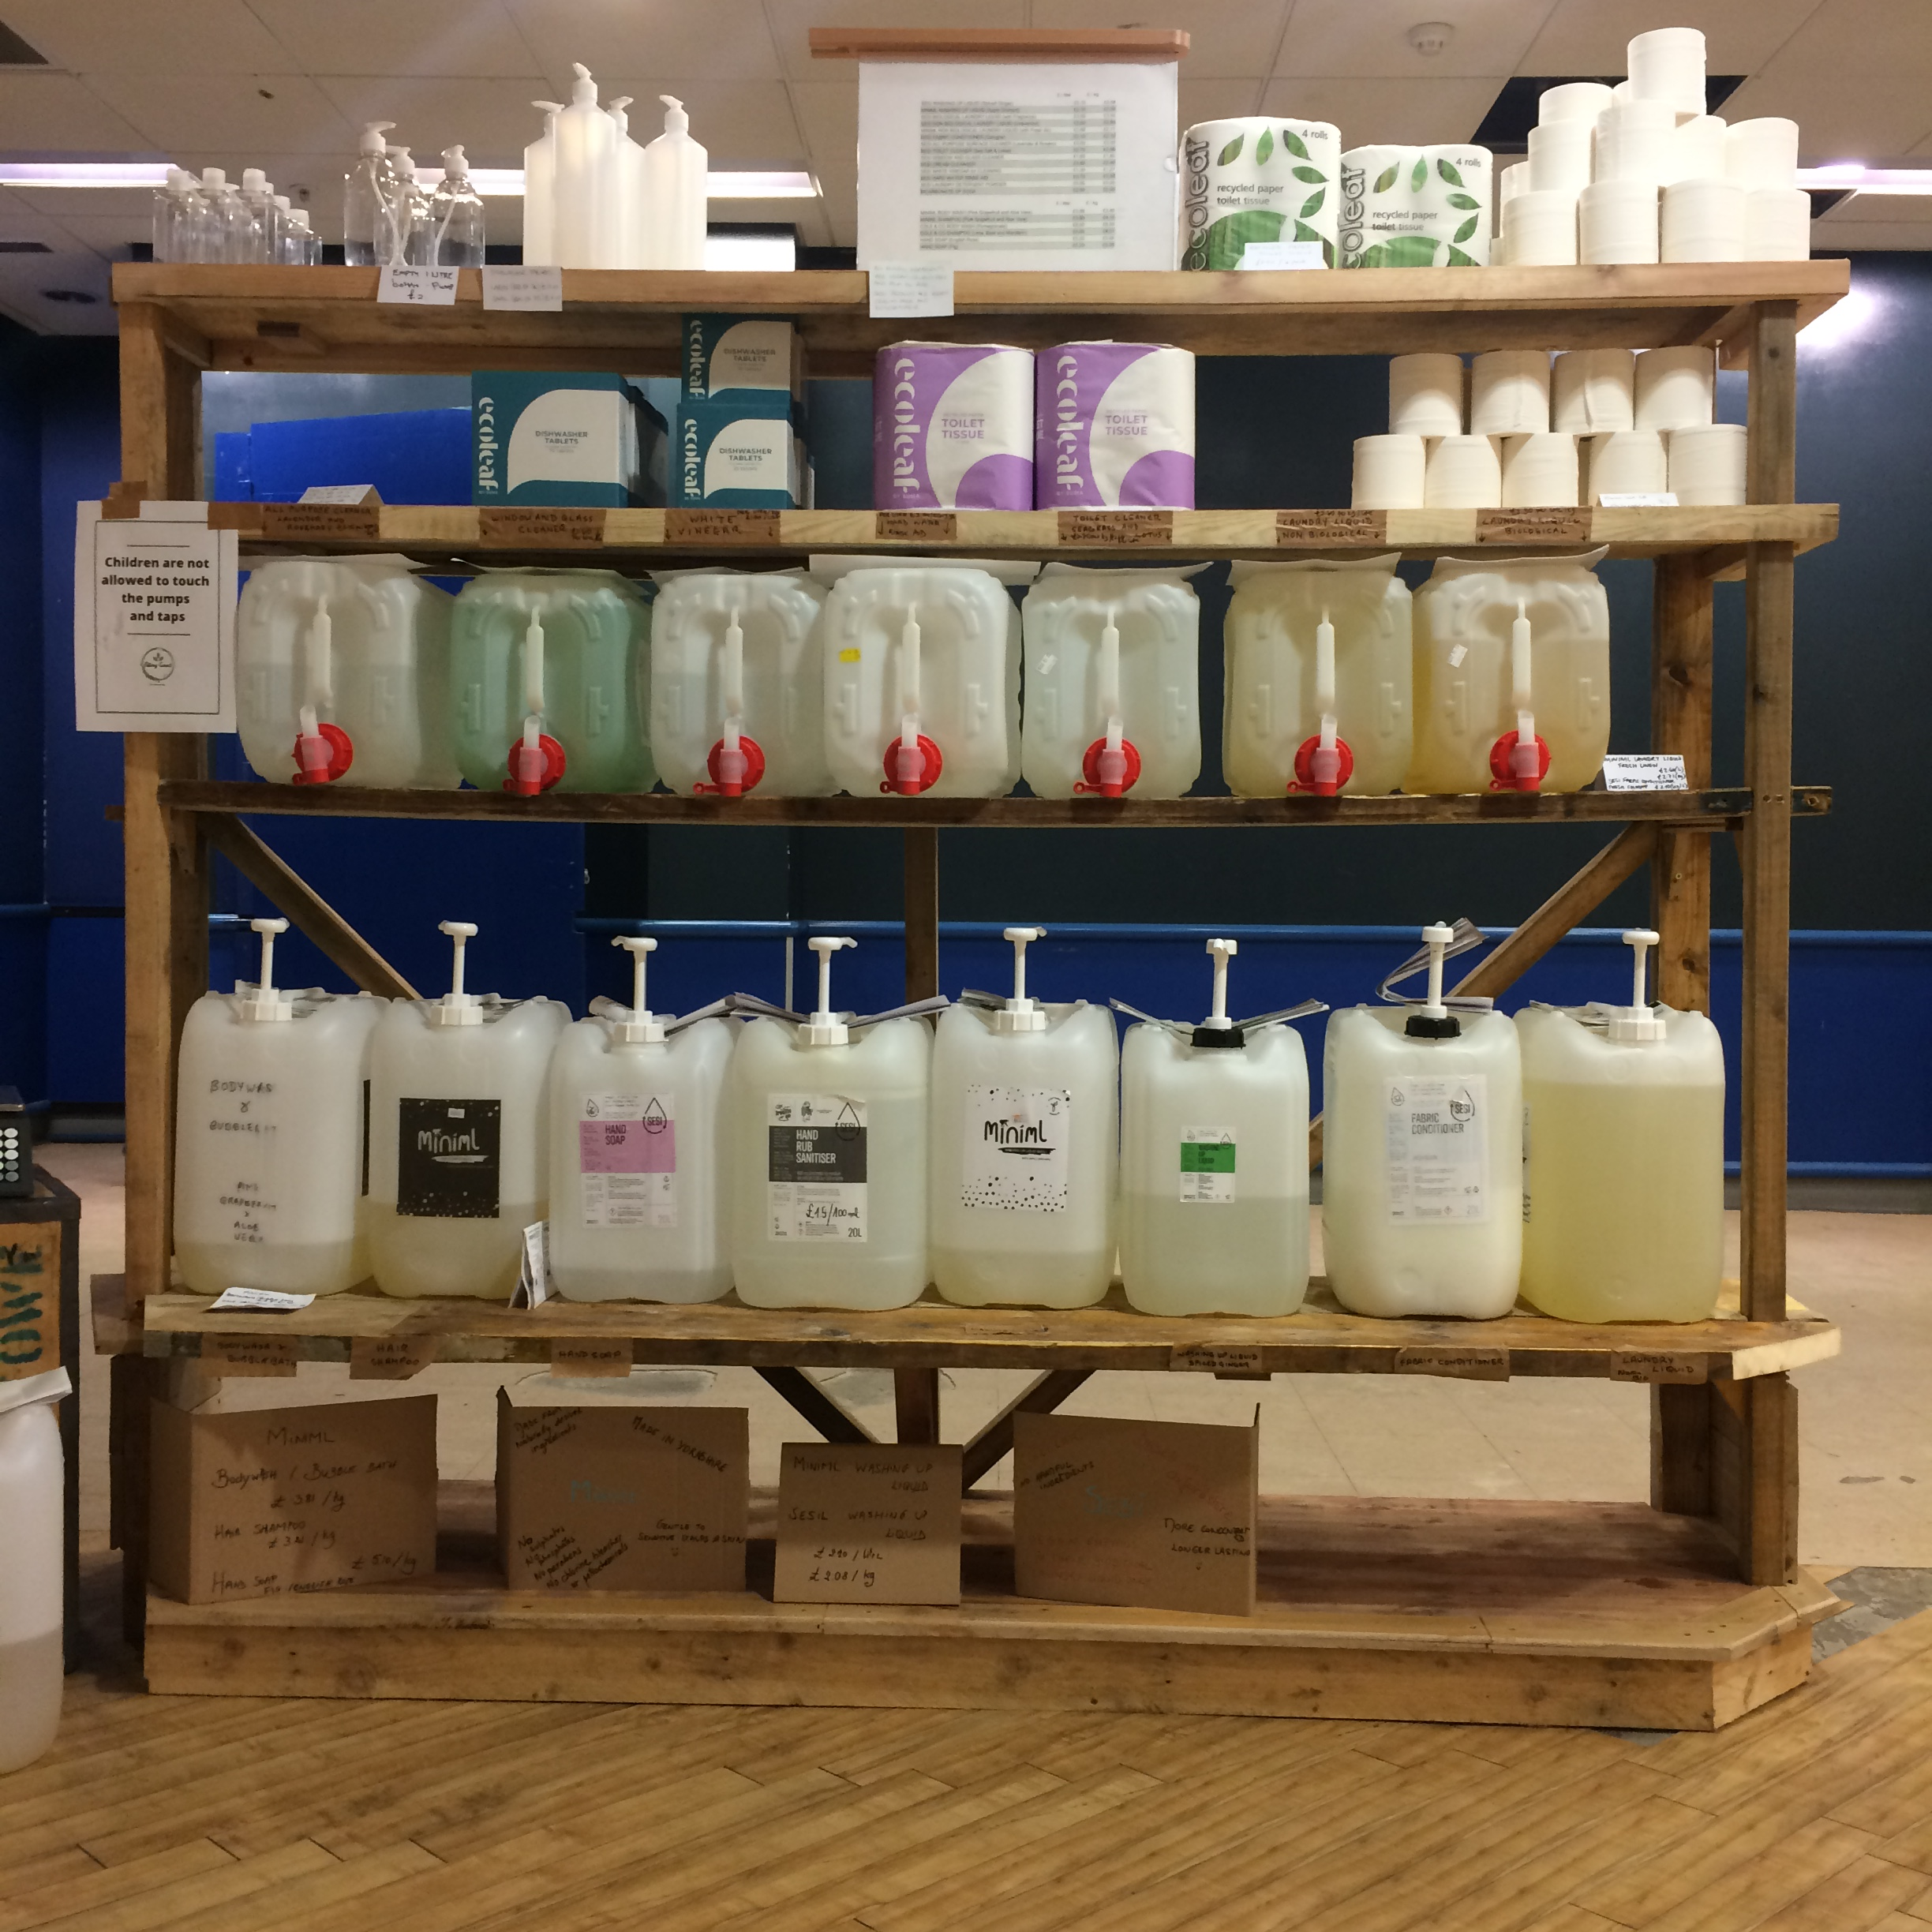
What do we actually do to be as circular as we can?
Shop operations :
Food safety measures adapted to not use single use items
Ex : reusable cloths, as few antibacterial chemicals as possible
Constant challenge of suppliers so that they use less packaging, or better packaging
Seek for circular suppliers – and encourage many to become circular suppliers.
Labels on reused paper – reused blu-tack
Paperless operations where we can

Slide 10
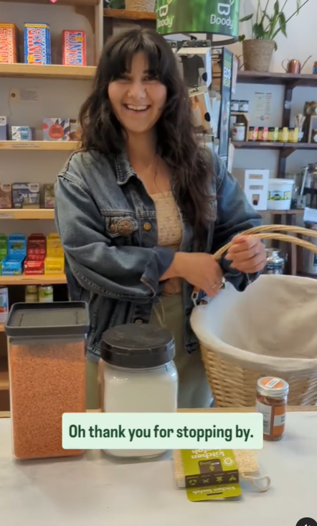
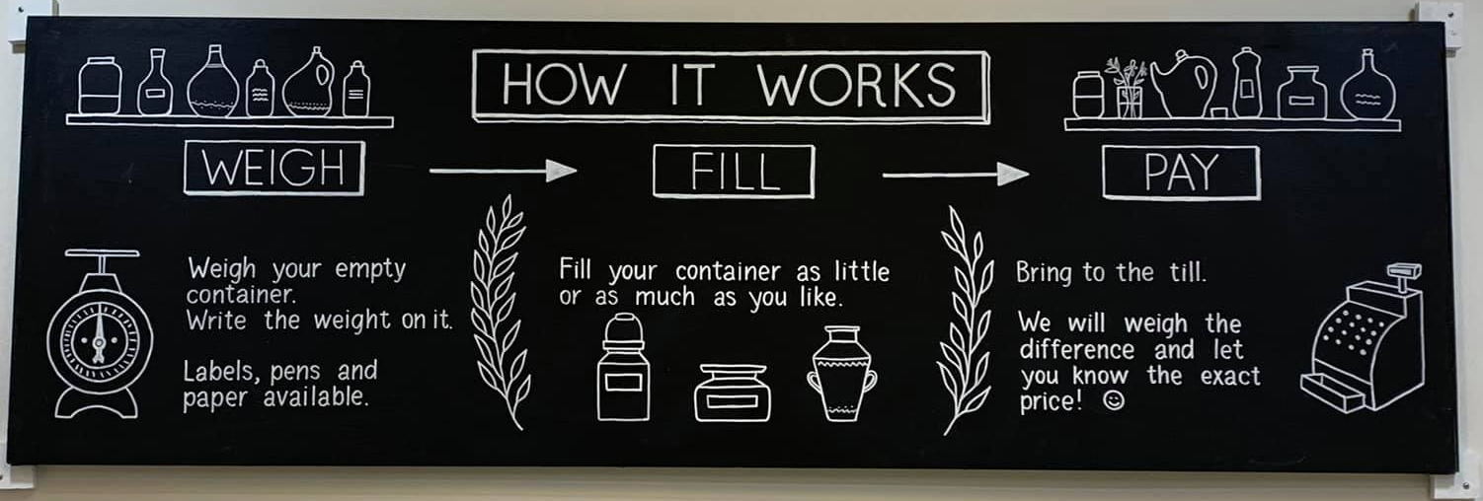
What do we actually do to be as circular as we can?
Full range of products on refill…
- BYO container
Take a container for free
Pay for a paper bag
Encouragement to bring back packaging where possible (honey, cosmetics…)

Slide 11
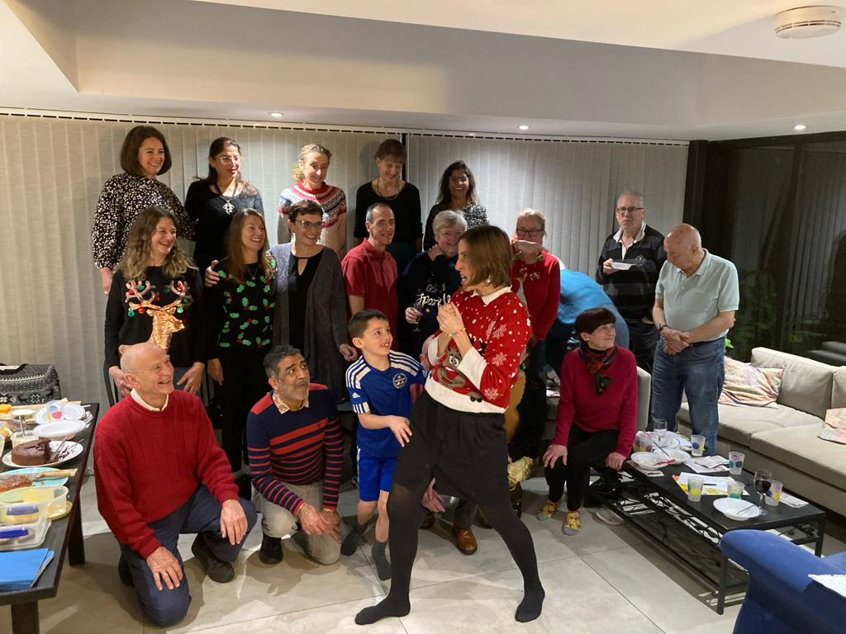
What do we actually do to be as circular as we can?
Use of the repair café
Use of our best knowledge !! We try hard !!
Collateral benefit ….
Fabulous community platform for reuse of things beyond the shop products

Slide 12
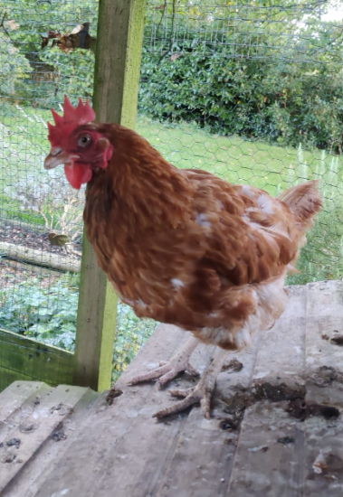
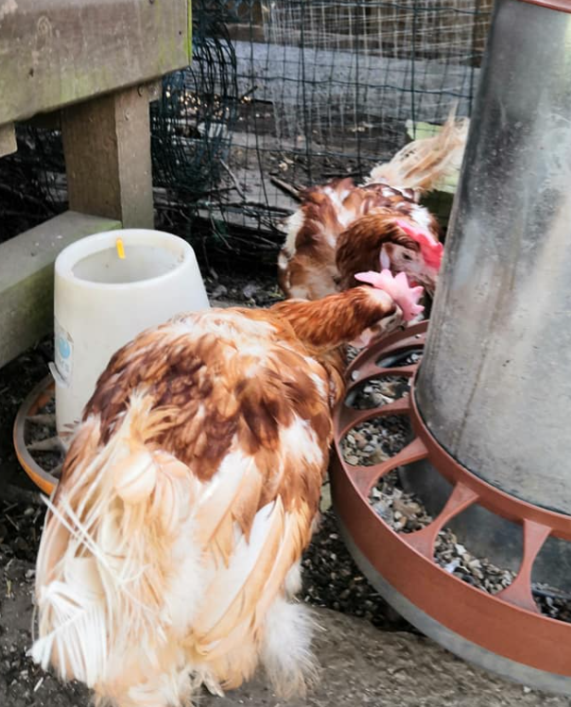
What do we actually do to be as circular as we can?
Low amount of waste!
Cardboard recycled
Food spillage goes to Sophie’s chicken
… beware of recycling promises…

Slide 13
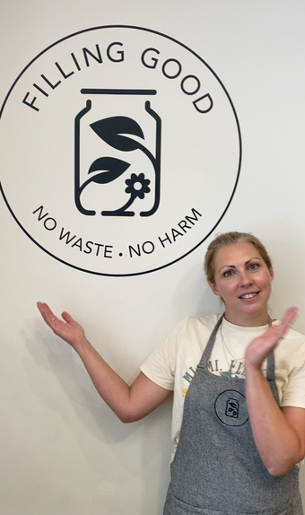
What are the limits
We are still generating waste
Sometimes easier and quicker to “buy new”
Our operations are labour intensive
Our business model is fragile
Low recurring sales of reusable products

Slide 14
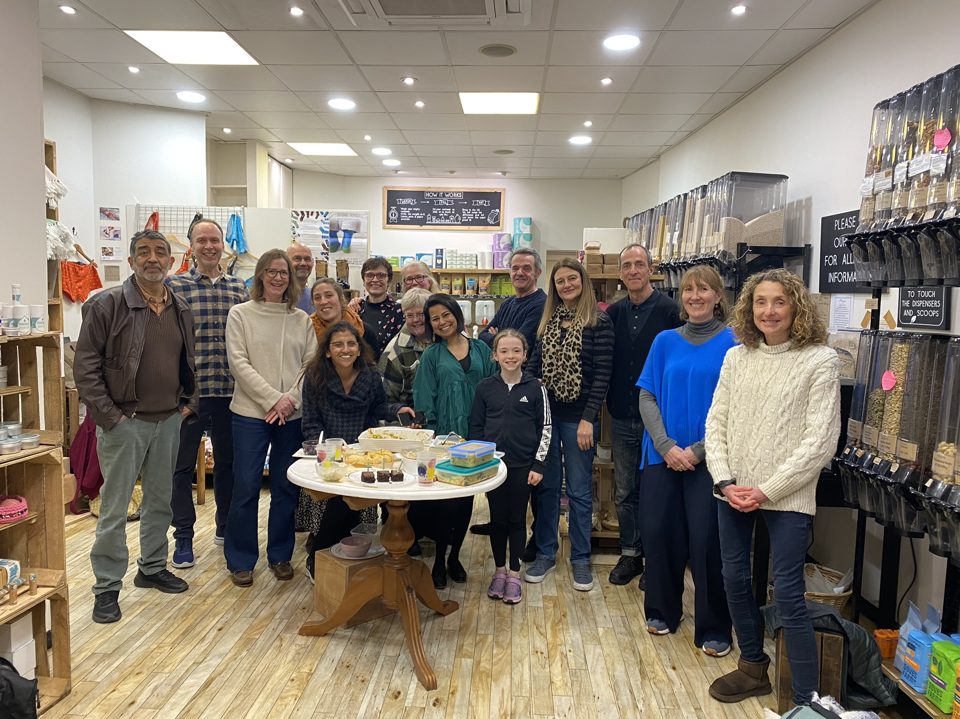
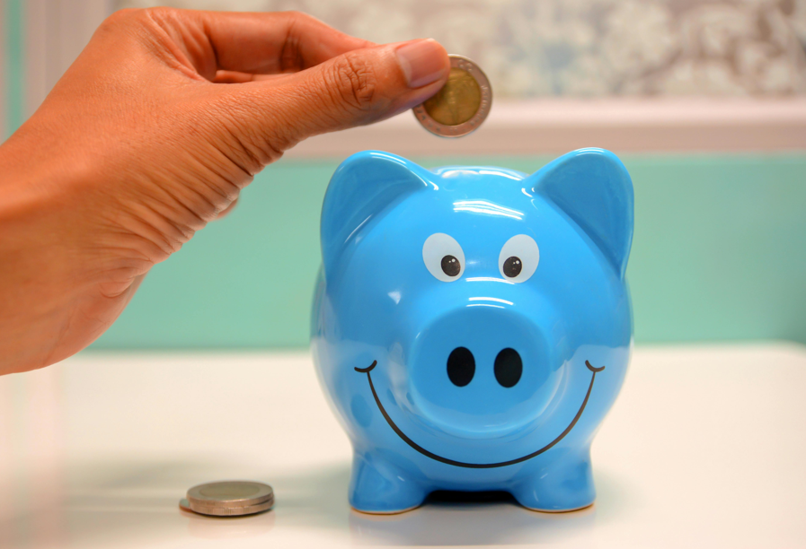
Overcompensated by many benefits!
Undeniable cost savings
for equipment and repairs – we owe our cash position to it!
Community alive
Not efficient, but robust
More than 181 000 pieces of packaging
saved so far!
Cheaper options
(cleaning products, dried fruits, spices, soy sauce, and many more…)
83% of our customers come back…
Once you start, you are not looking back!

Slide 15
Thank you! Questions?
Want to shop with us?
Volunteer with us?
Contact us through our website or
Come and say hello!
www.fillinggood.co.uk
Facebook : fillinggoodltd
Insta : fillinggoodltd

Slide 16
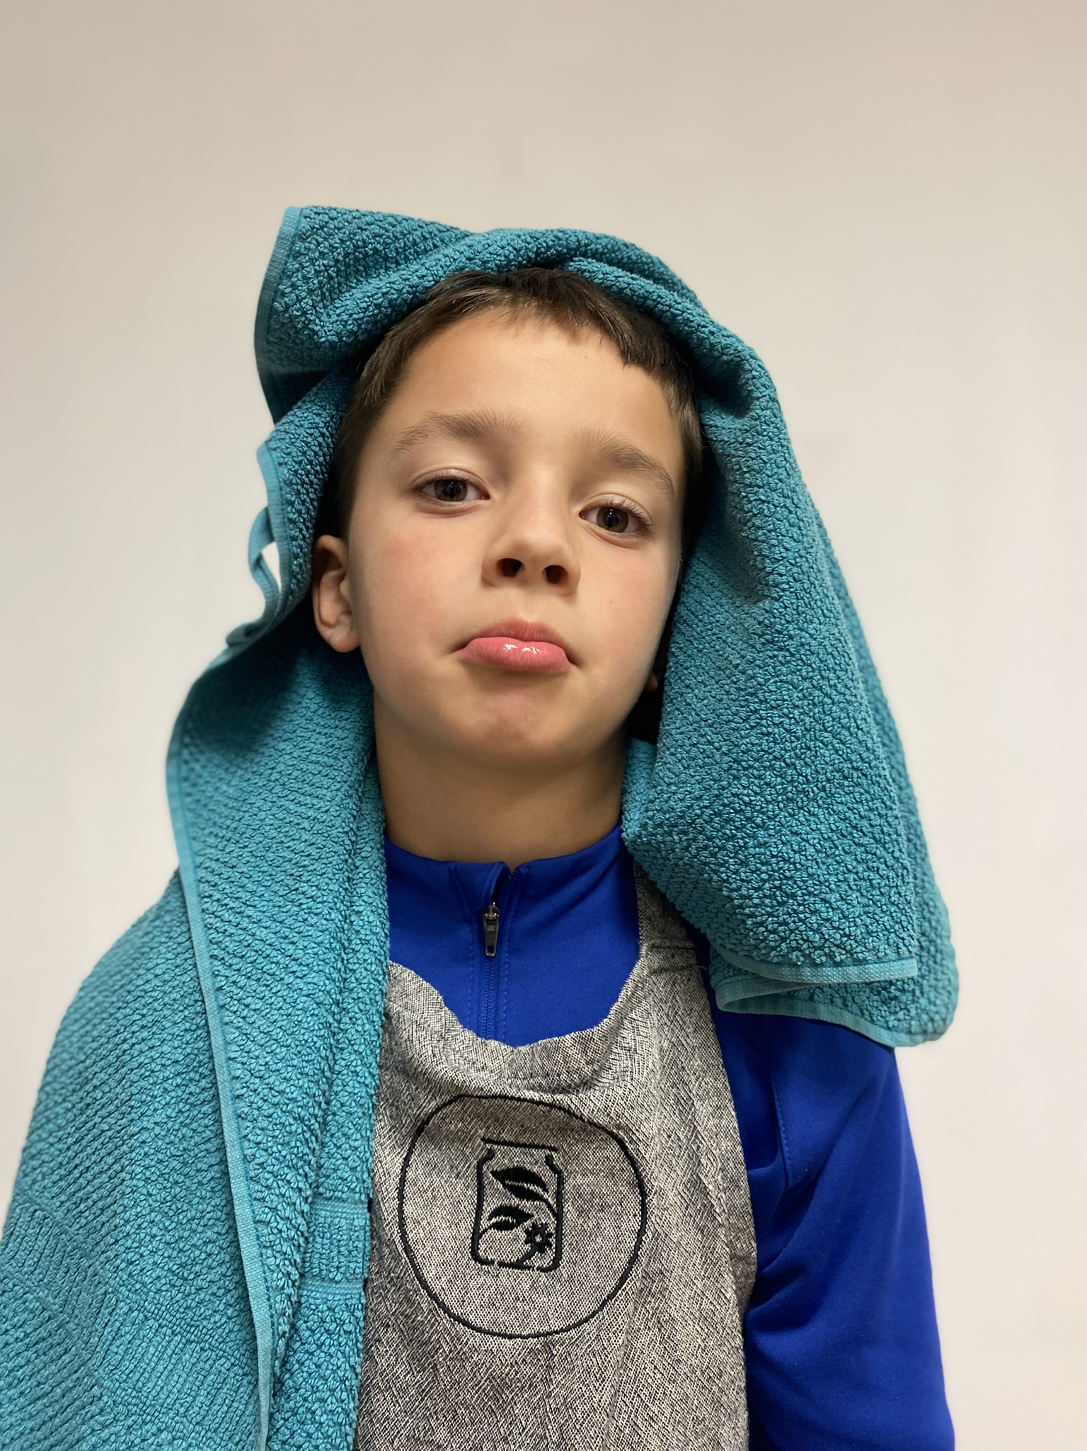
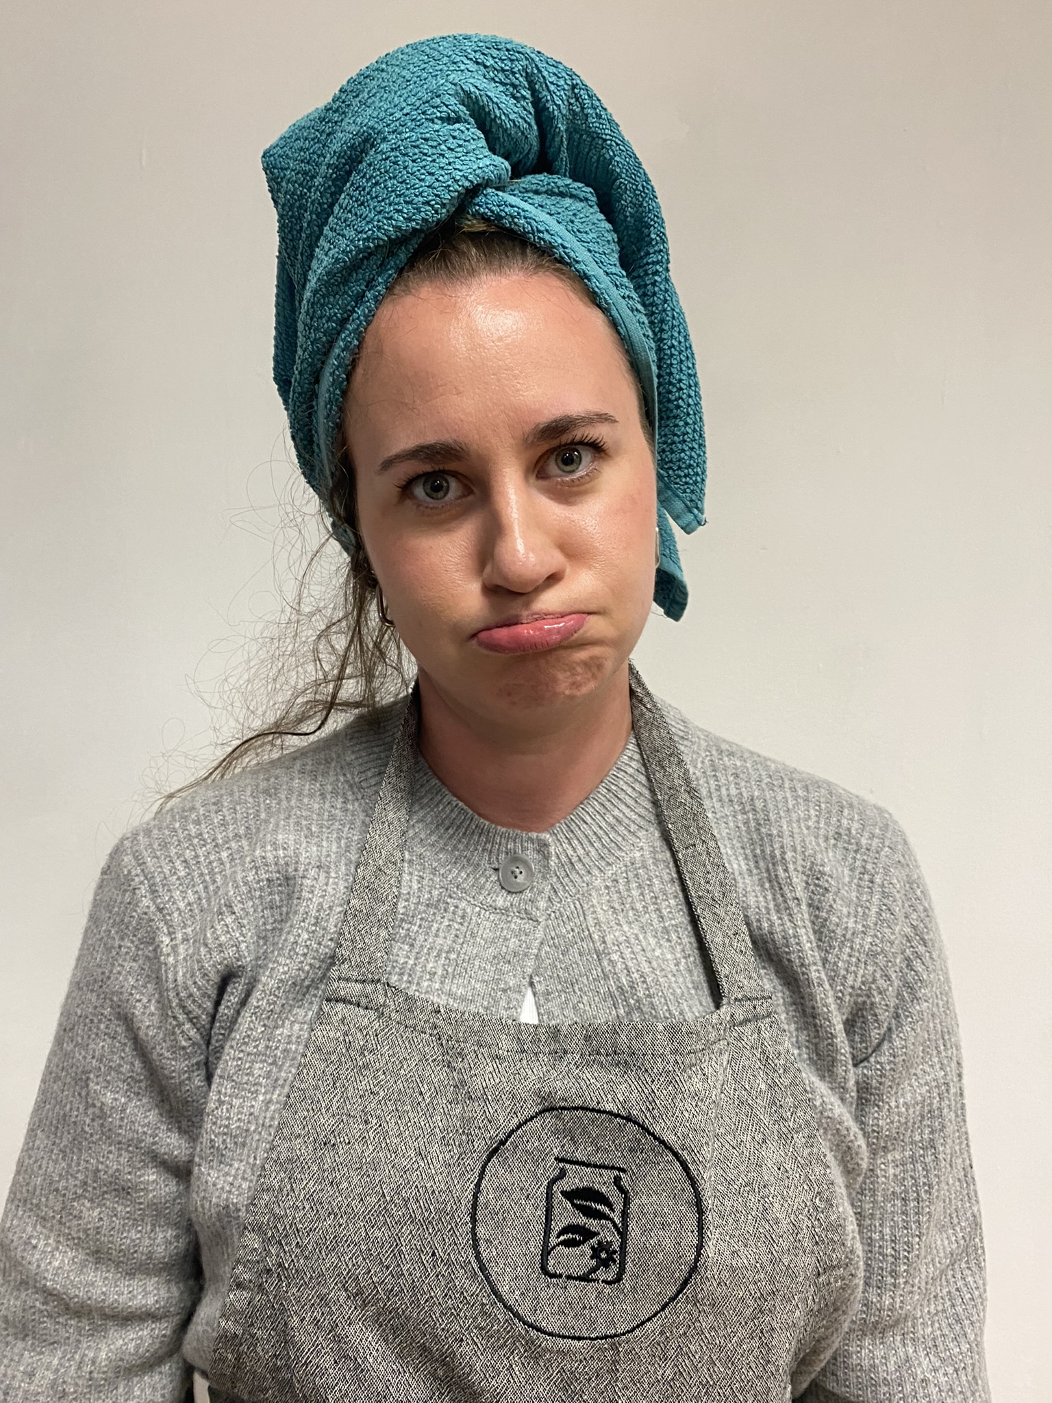
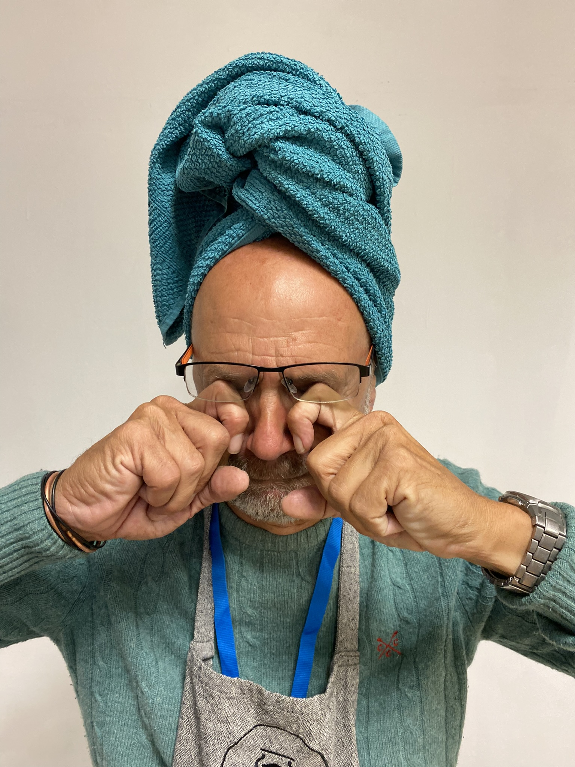
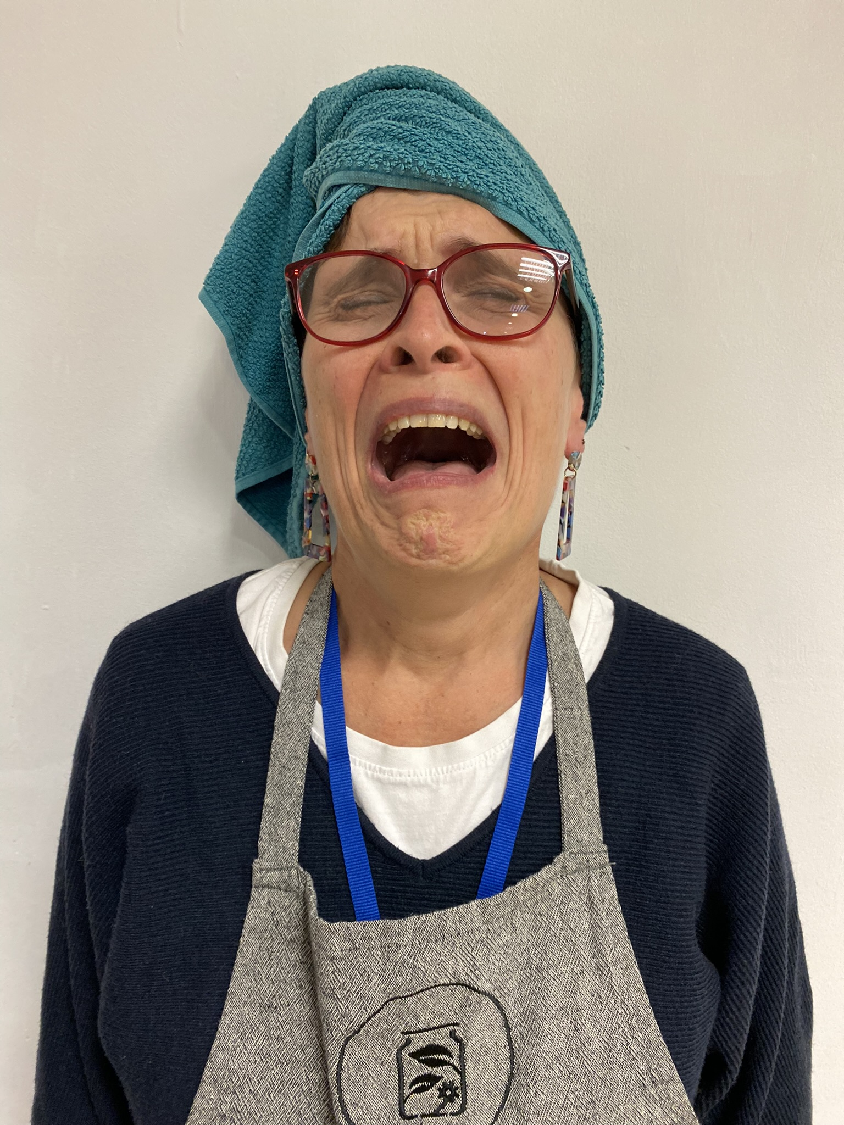
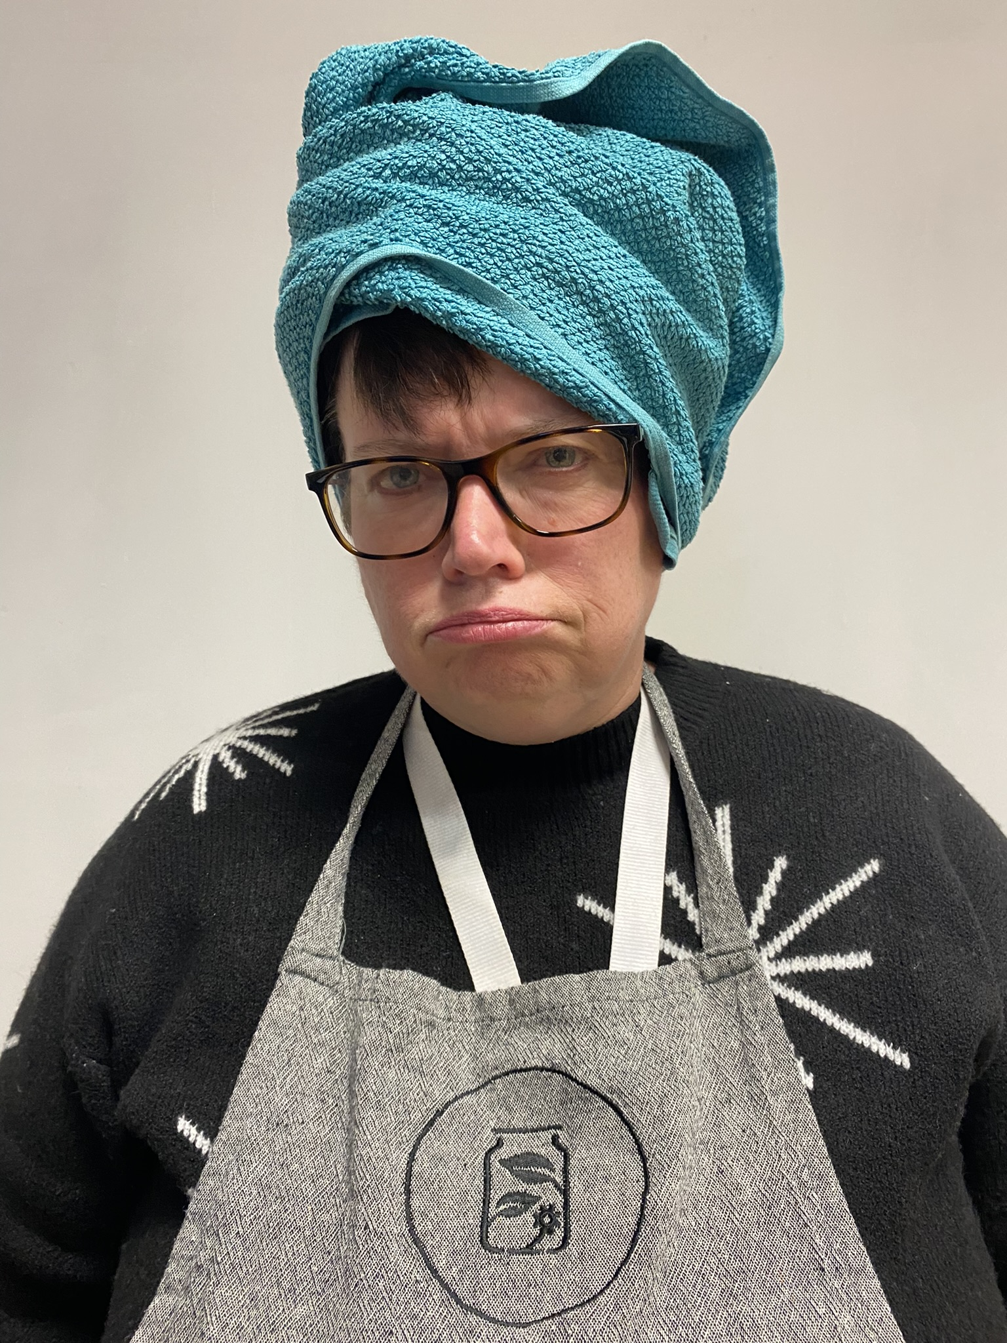
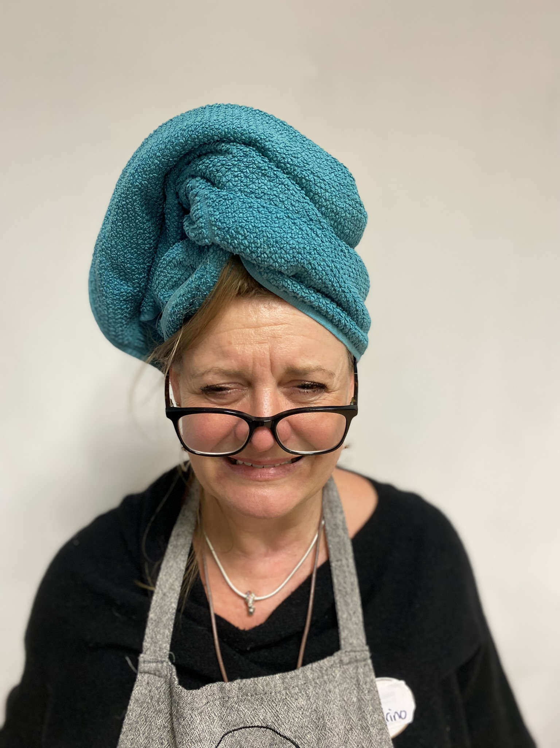
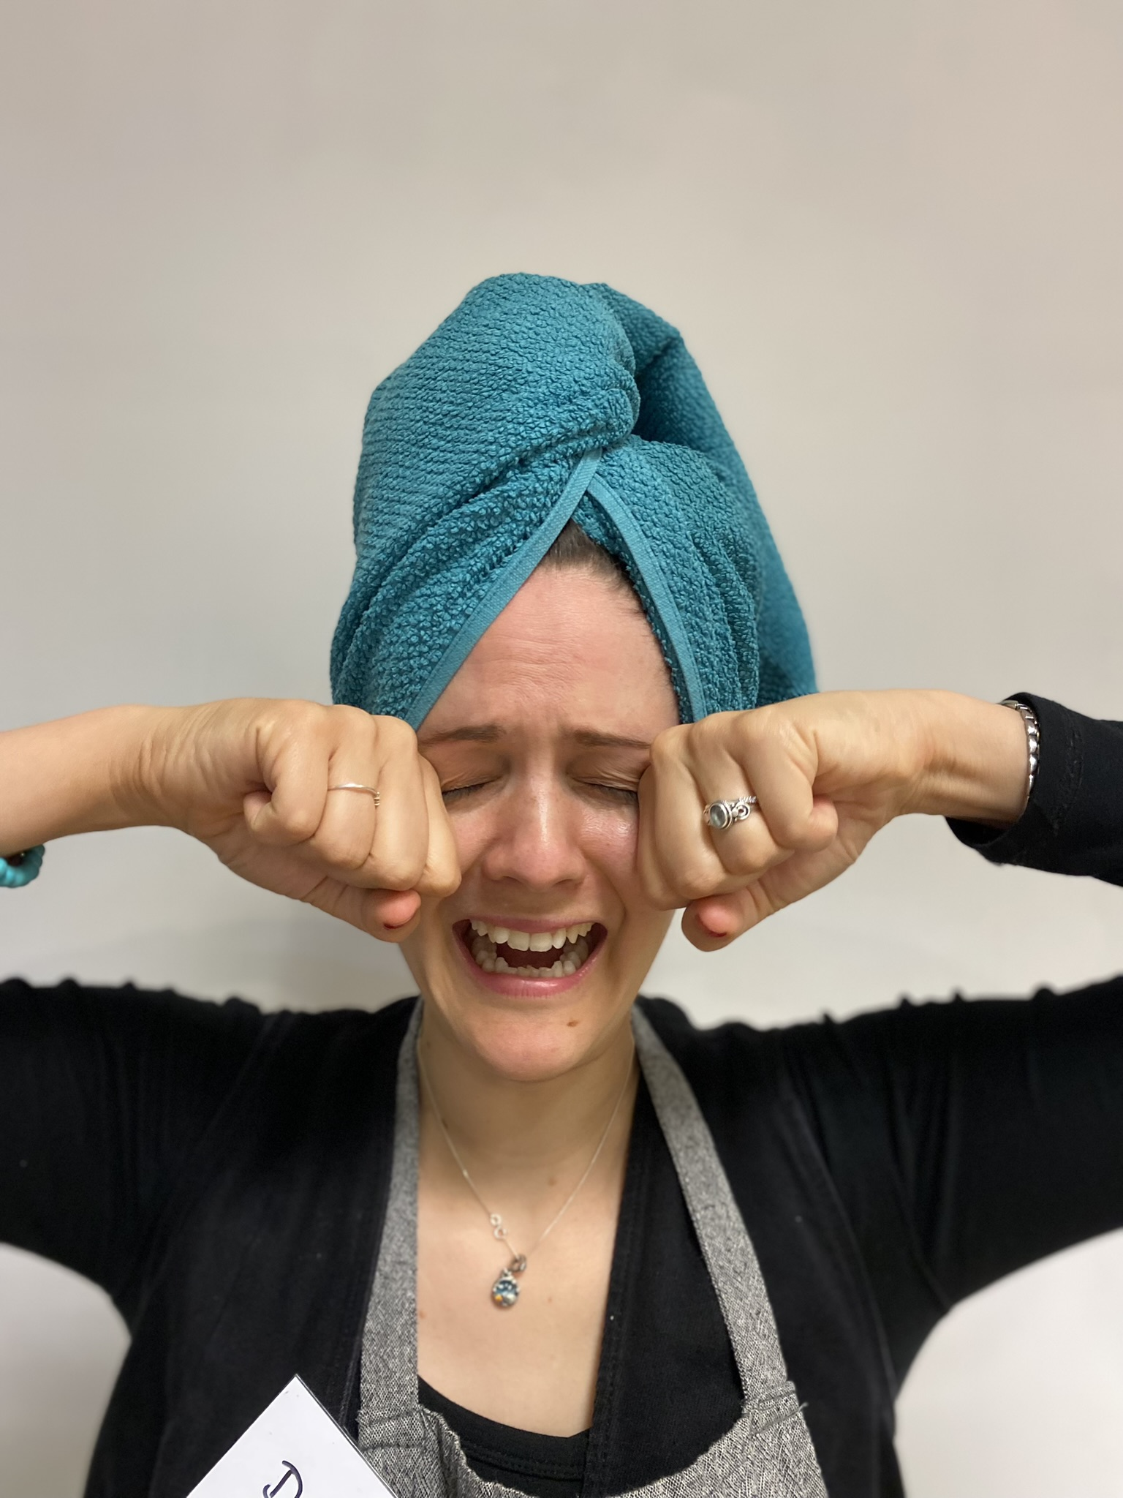
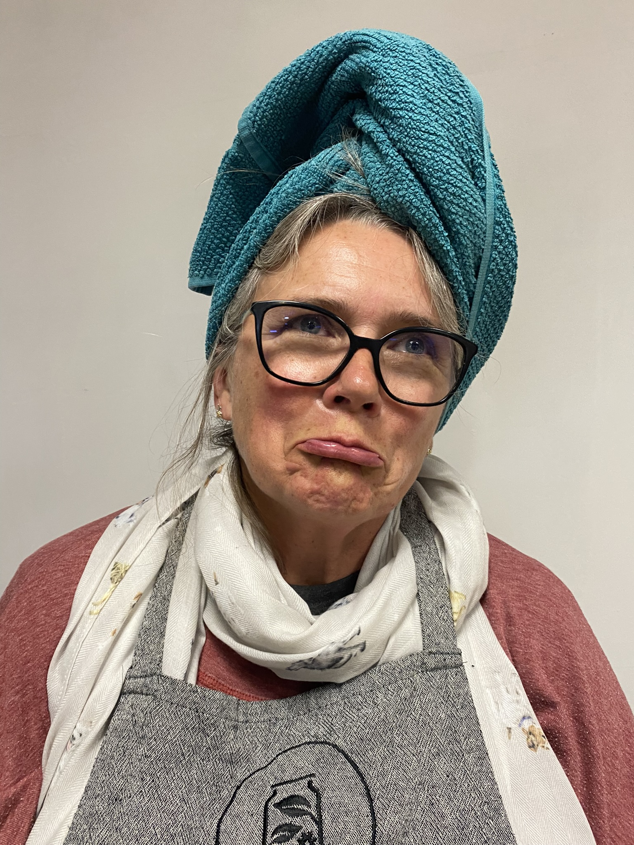
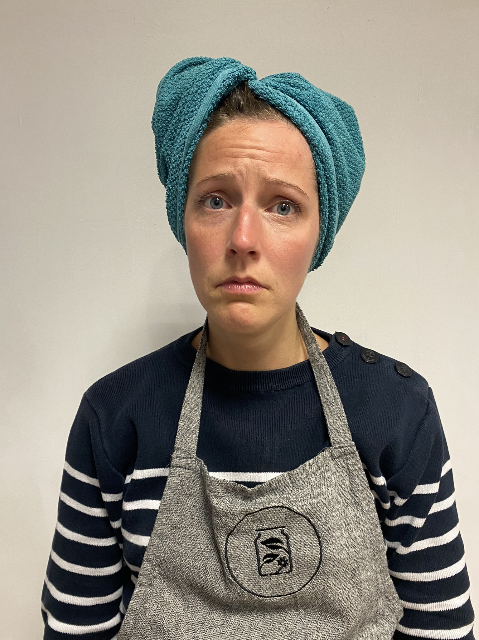
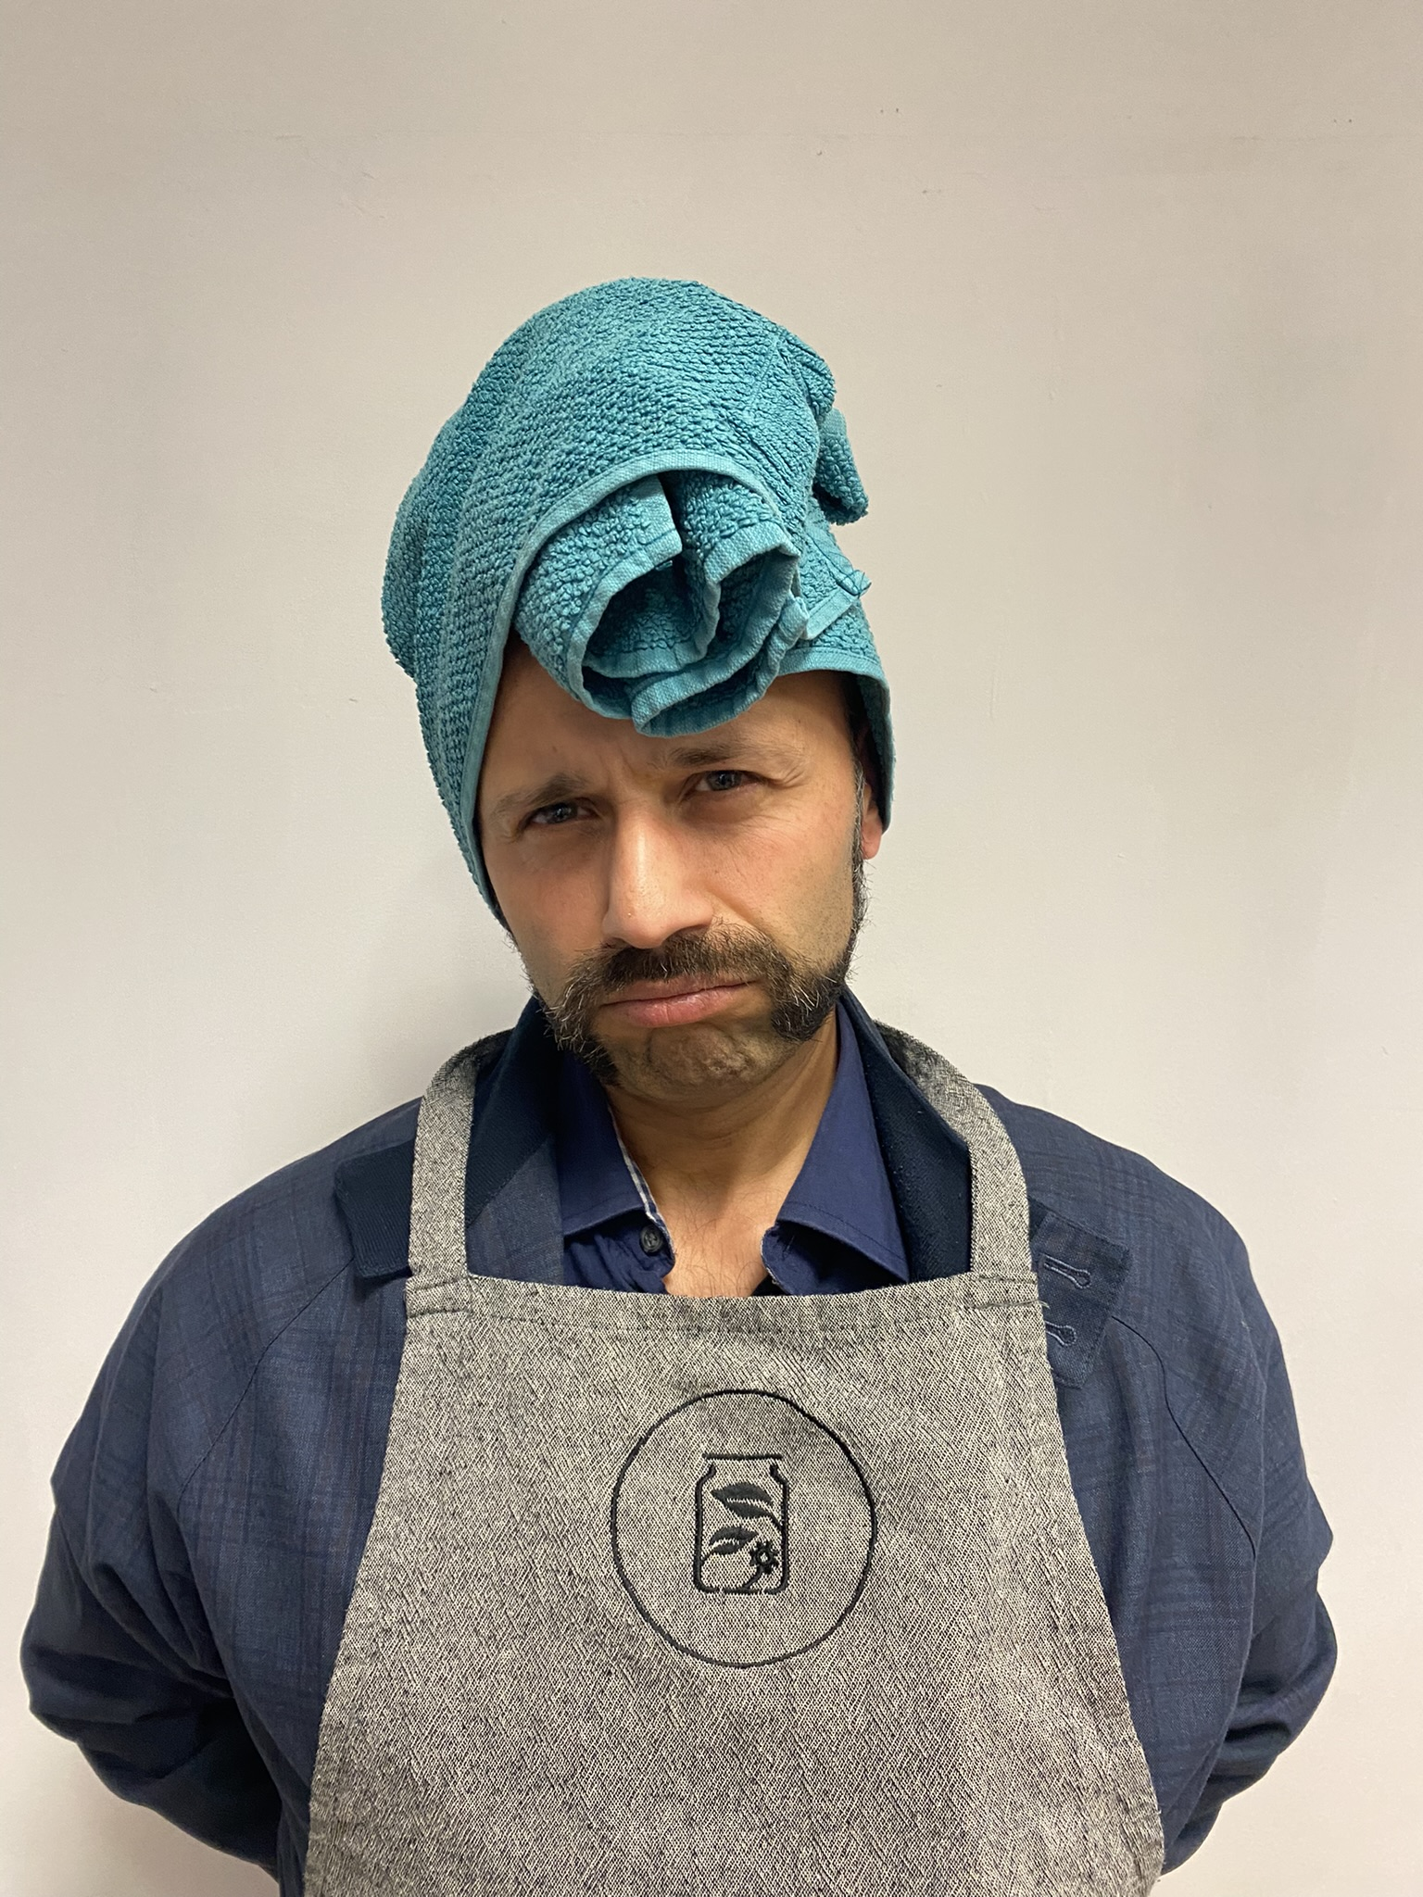
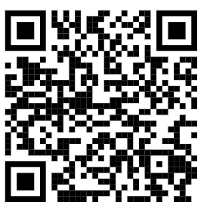
Help us get our smiles back
Fundraiser: https://gofund.me/ee7b7c0c

