Slide 1
Flooding and Climate Change
RBWM Flooding Team

Slide 2
Introductions
Ben Crampin (Flood Risk Manager)
Sian Matthews (Sustainable Drainage Officer)

Slide 3
Agenda
What is the LLFA?
Flooding now and in the future
What can be done to minimise the impact of flooding?

Slide 4
What is a Lead Local Flood Authority?
County/Unitary Authority
Given duties and powers following Pitt Review 2007 and Flood & Water Management Act 2010
Has enforcement powers over maintenance and management of Ordinary watercourses
Environment Agency (EA) are the strategic authority for all flooding and the relevant authority for Fluvial flooding and Main Rivers
Risk Management Authority for Surface Water and Groundwater flood risk

Slide 5
LLFA partners
Flooding RBWM
Environment Agency
Thames RFCC
Parish Councils
Catchment Partnerships
Thames Water
Resident
RBWM Internal Teams
RBWM Internal Teams
Highways
Transport
Legal
Emergency Planning
Planning

Slide 6
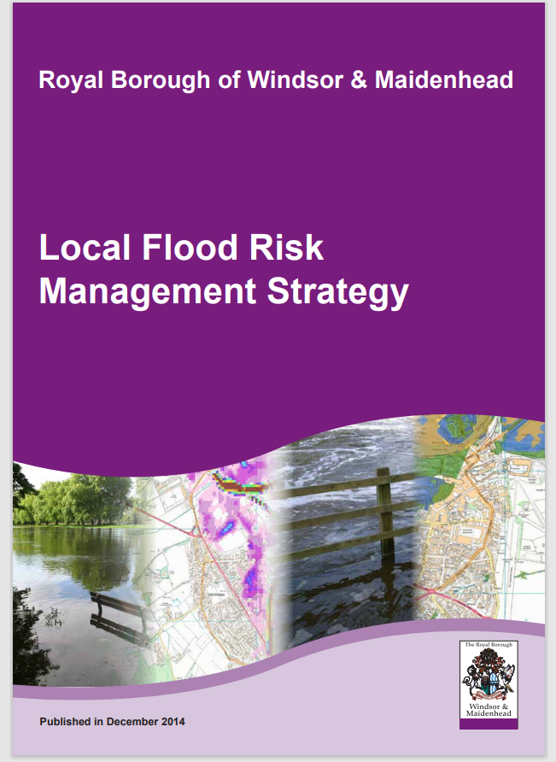
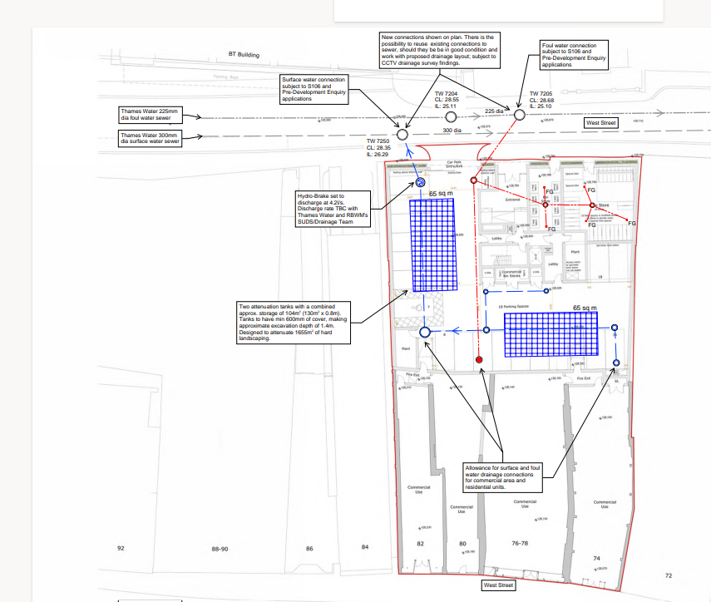
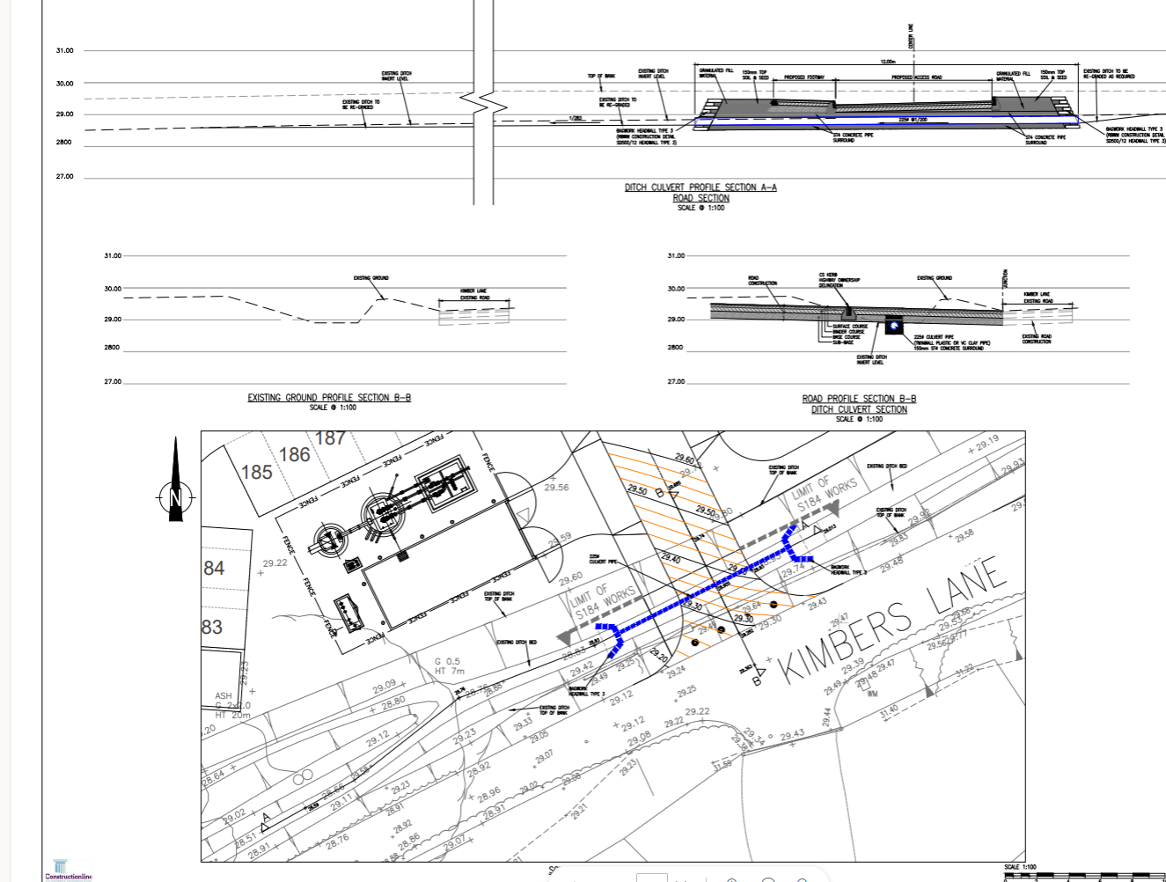
Duties of a Lead Local Flood Authority
Duty to create a Local Flood Risk Management Strategy
Duty to investigate flooding
Maintain a register of flood risk assets
Statutory consultee for major planning applications
Duty to review applications for works on ordinary watercourses

Slide 7
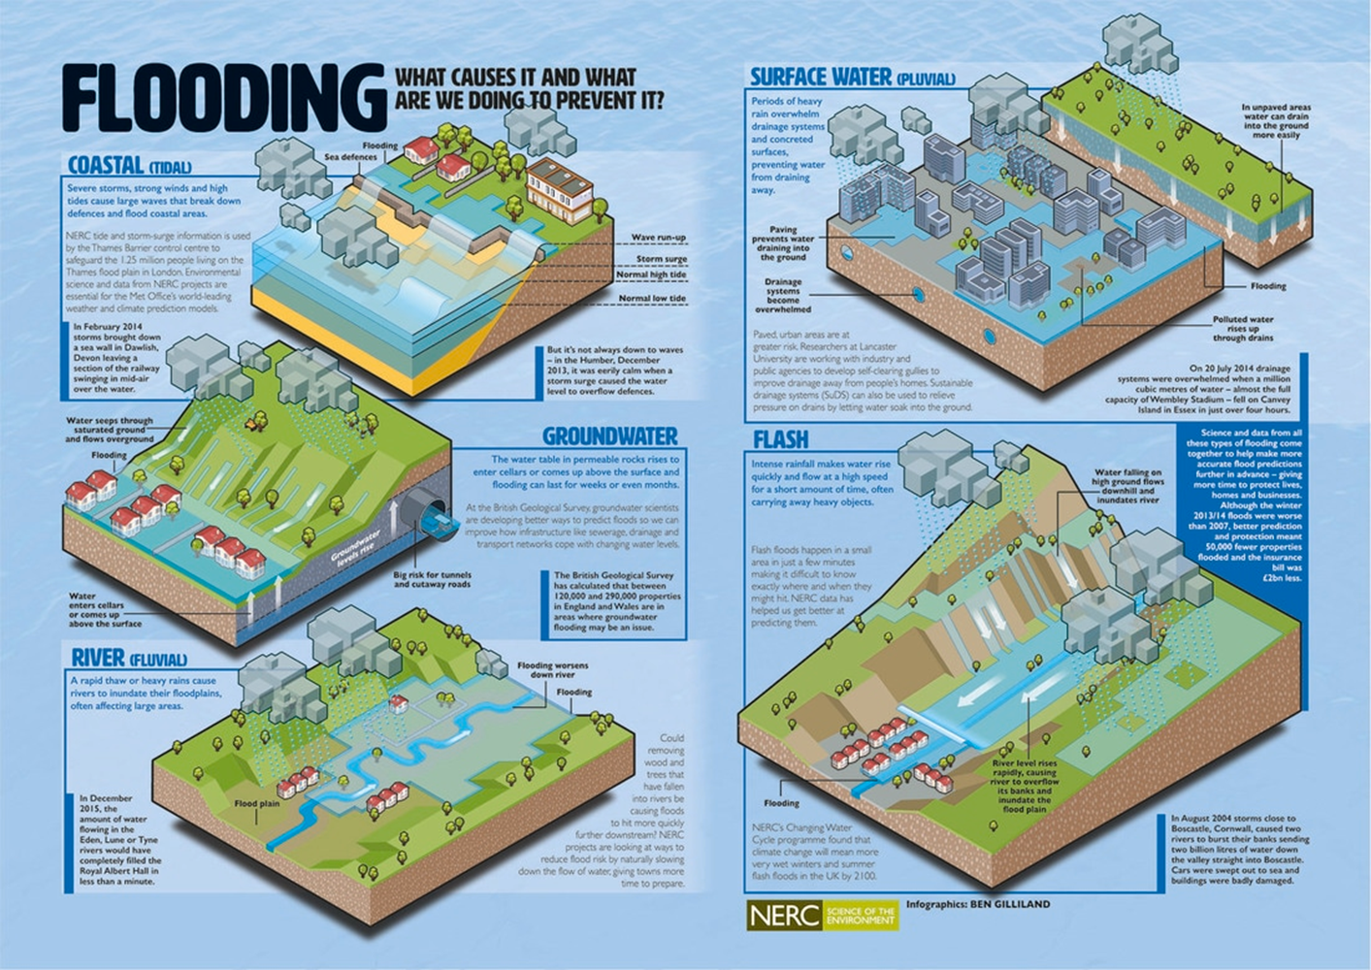
Flood Risk in RBWM
Areas of the borough at risk from:
Fluvial Flood Risk
Surface Water Flood Risk
Groundwater Flood Risk
©NERC, 2024

Slide 8
CURRENT Flood Risk in RBWM - FLUVIAL
Notes:
RBWM SFRA 2017 states that:
26% of the borough at risk of Fluvial flooding
This includes approx. 13,000 residential properties and 1800 commercial premises

Slide 9
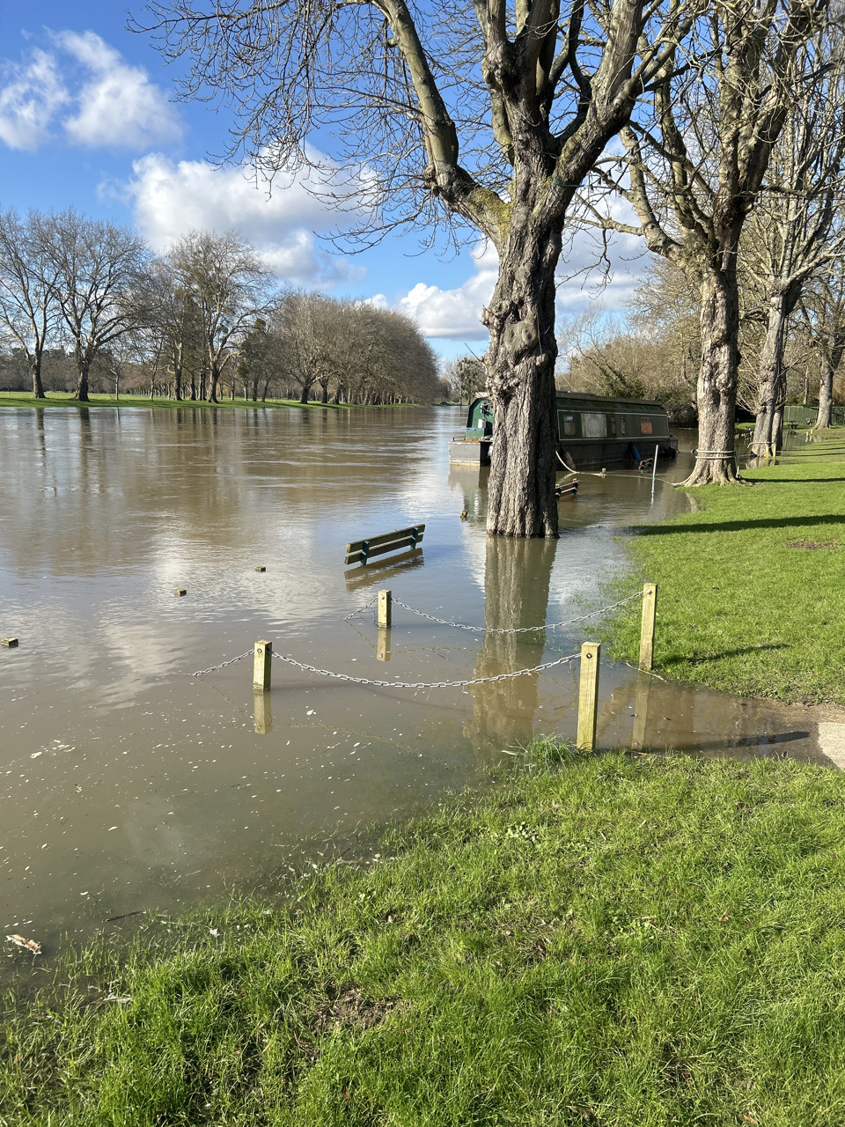
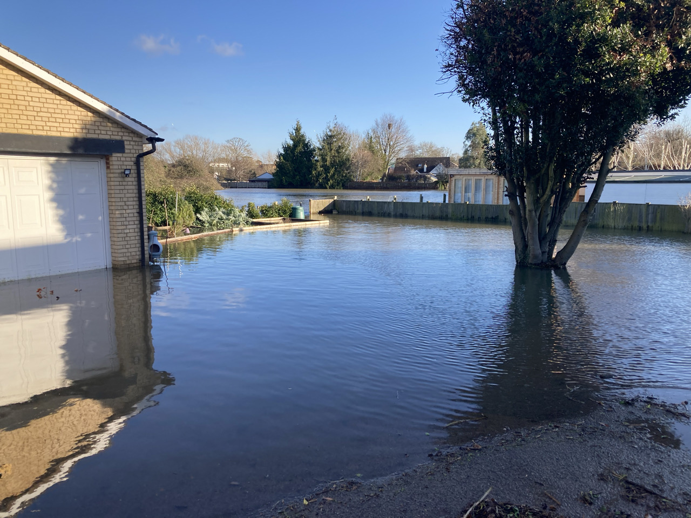
Notes:
January 2024 saw widespread fluvial flooding across the borough with areas such as Hurley, Bisham, Cookham, Datchet, Wraysbury and Old Windsor being flooded from the Thames
Due to 0 soil moisture deficit and

Slide 11
CURRENT Flood Risk in RBWM – SURFACE WATER
Notes:
1,559 residential properties and 1,125 non residential properties at risk of surface water flooding

Slide 12
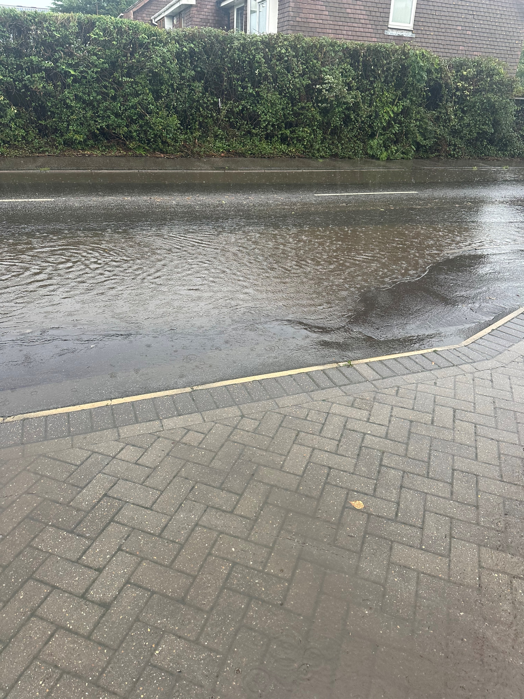
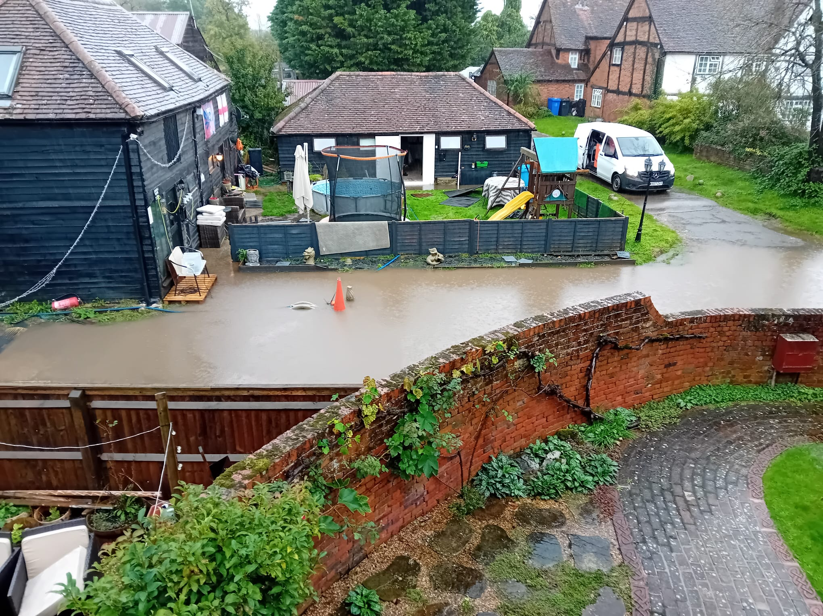

Slide 13
Future flood risk
Met Office has observed that the UK was 9% wetter during 2011-2020 compared to 1961-1990.
Since records began, 6 out of the top 10 wettest years have occurred since 1998.
The number of days exceeding 95-99% of 1961-1990 average rainfall has increased in the last decade. As have rainfall events exceeding 50mm.
Not guaranteed fluvial flooding will increase significantly as flooding is caused by several other factors but is likely.
Summer storms predicted to be more common and more intense

Slide 14
Who is responsible for managing flood risk?
EA
RBWM
Developers
Landowners
Business Owners
Parish Councils
Property owners
RMAs are not responsible for preventing flooding from occurring to properties
Notes:
RMA = Risk Management Authority

Slide 15
How does RBWM Manage flood risk?
Highway Drainage Maintenance
Capital projects
Consultation for surface water strategies for Major Planning Applications
Enforcement of watercourse maintenance when issues are reported
Working with communities to help them understand their risk and what steps they can take to manage their own risk.
Creation and maintaining of a Local Flood Risk Management Strategy

Slide 16
Other ways of managing flood risk
Retro fit of Sustainable drainage features
Property resilience/resistance measures
Using development as an opportunity for improvement
Community and personal resilience planning

Slide 17
Sustainable Drainage systems

Slide 18
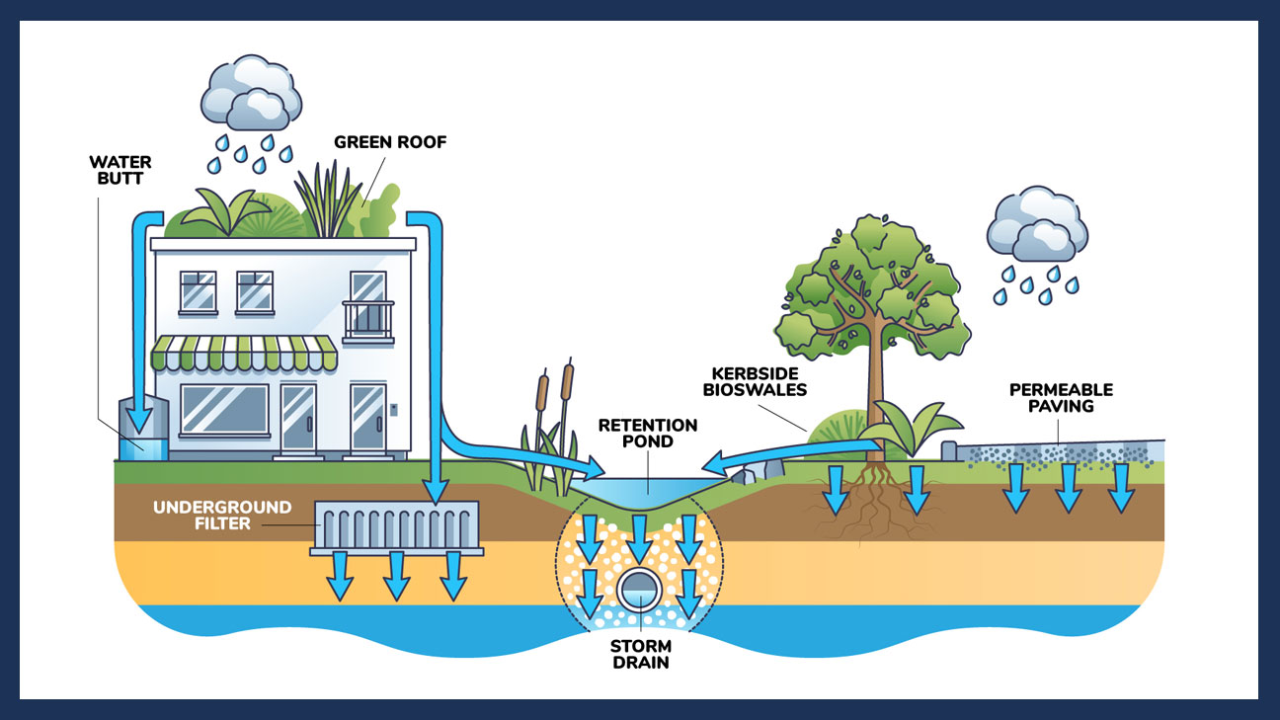
What are SuDS?
Sustainable Drainage Systems

Slide 19
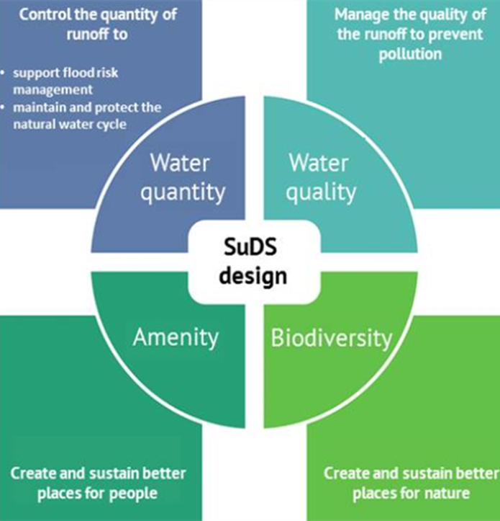
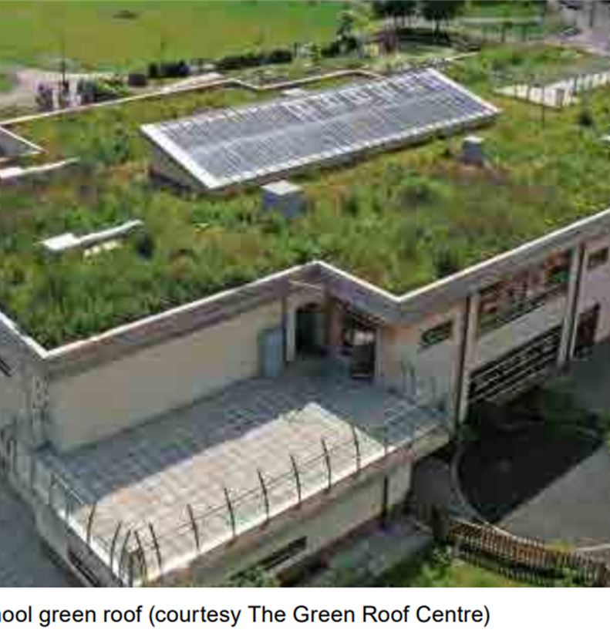
Why are SuDS important?
4 Pillars of SuDS Design
Environmental Benefits

Slide 20
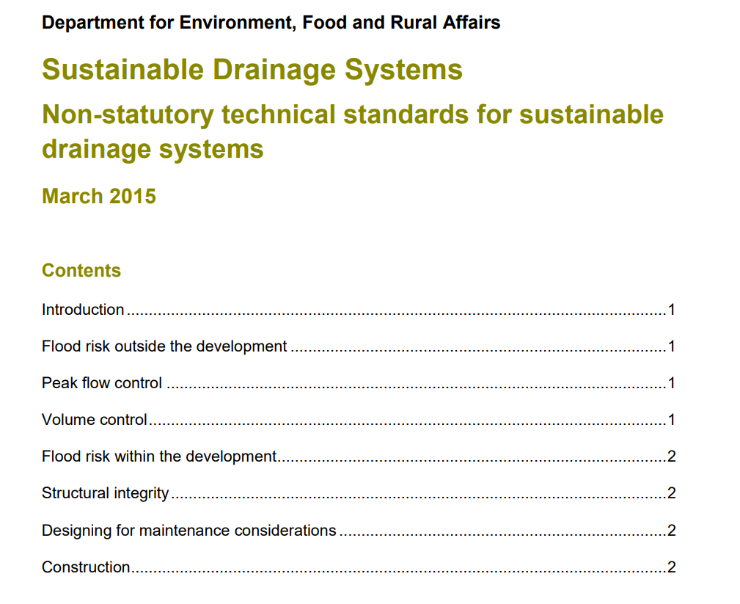
SuDS in Planning

Slide 21
SuDS in Planning
Surface Water Hierarchy

Slide 22
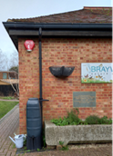
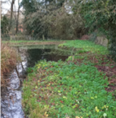
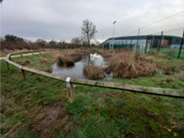
How are SuDS used?
Water Butt- Braywick Nature Centre
Pond- Braywick Nature Centre
Attenuation Basin- Braywick Leisure Centre Sports Pitches

Slide 23
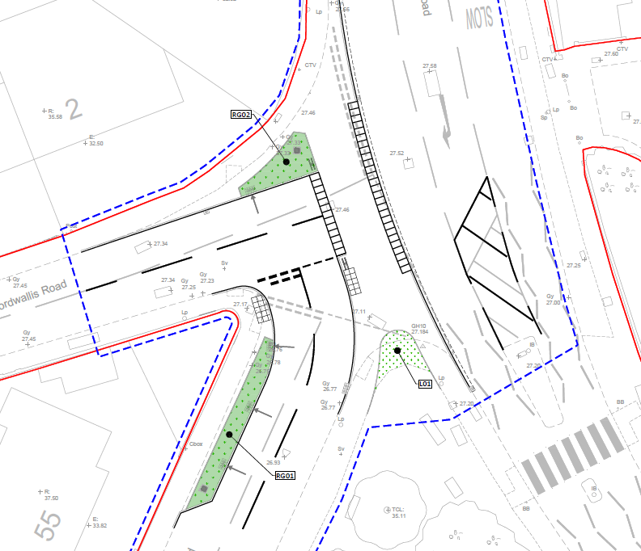
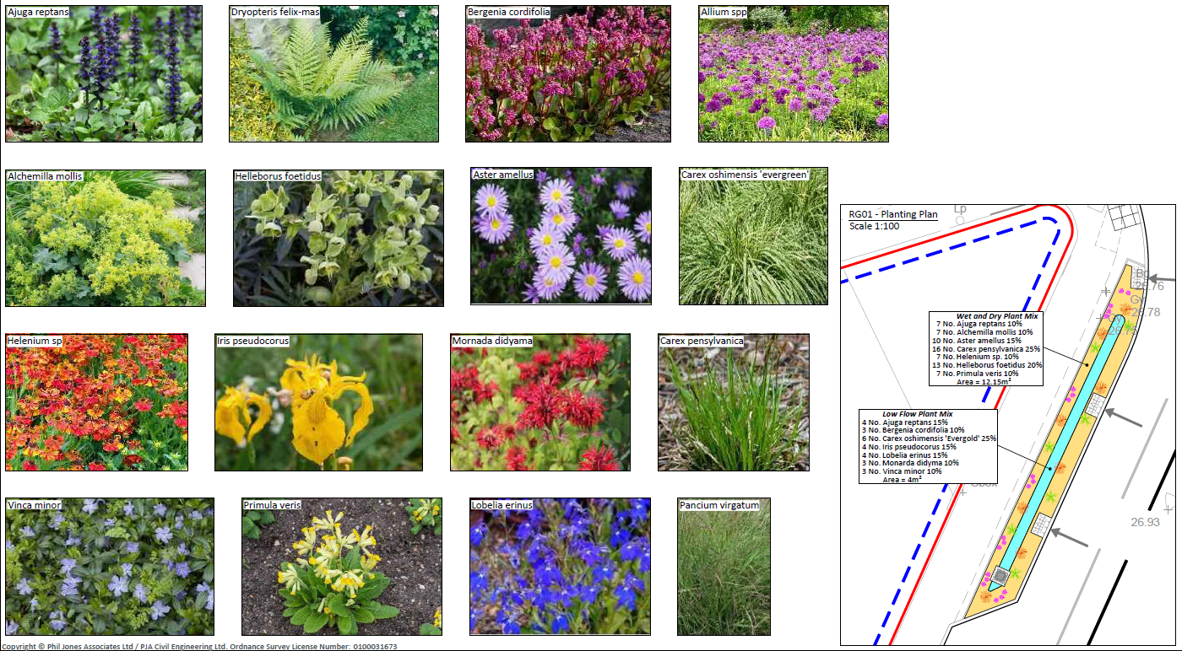
Norfolk Park SuDS Project
Rain Garden Construction
Rain Garden Plan
Rain Garden Planting

Slide 24
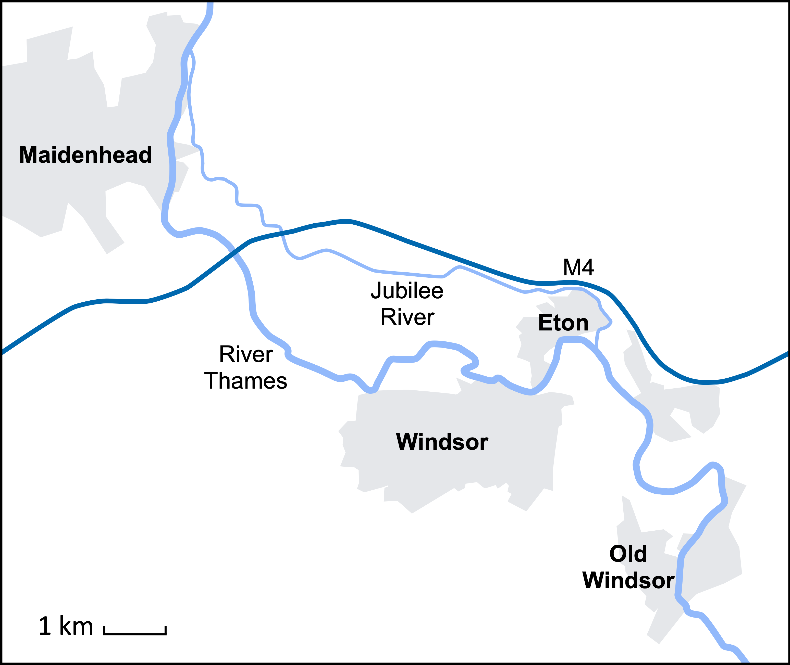
Capital works
Highway drainage upgrades
Larger flood alleviation schemes
Fluvial in partnership with the EA
Lead on Surface Water schemes
Council also undertakes regular cyclical maintenance of highway gullies every year

Slide 25
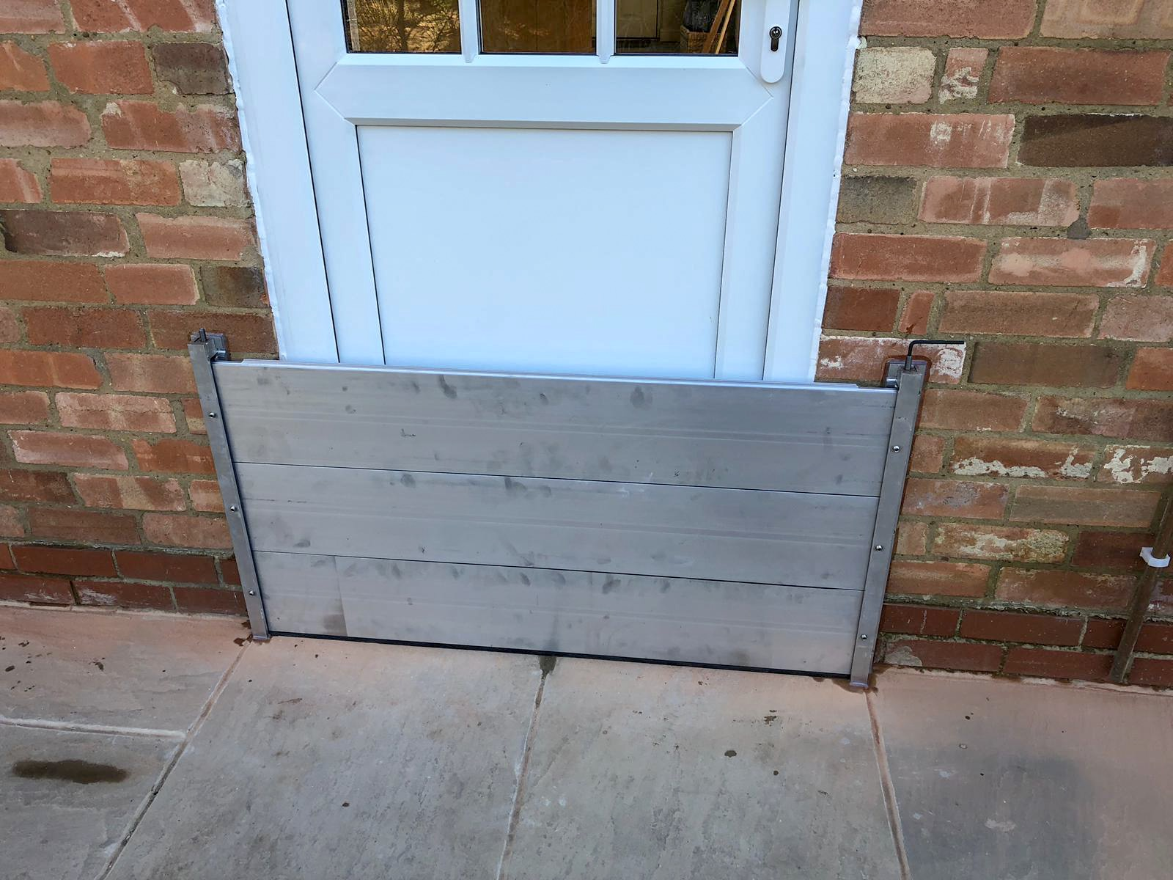
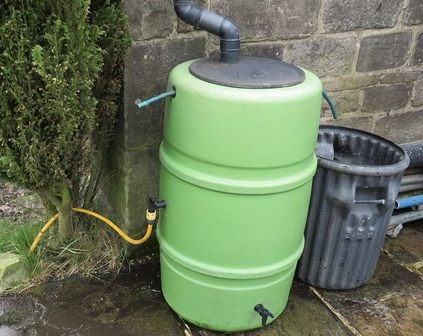
Responsibilities of property owners
Ultimately responsible for managing all risk to their own property
Can take steps if in an area of flood risk to minimise the impact
Property Flood Resilience measures
Resilience Planning
Retrofitting of SuDS

Slide 26
Local Flood Risk Management Strategy
Current strategy published in 2014
RBWM planning updates to bring more up to date
Will focus on how sources of local flood risk (surface water, groundwater and ordinary watercourses) will be managed in the borough.
Planning to restart work in coming months so please look out for consultation information

Slide 27
Contact Details
Email:
General Enquiries – flooding.enquiries@rbwm.gov.uk
Sustainable Drainage enquiries: Suds@rbwm.gov.uk
Report flooding via RBWM Website - Report a flooding or drainage problem | Royal Borough of Windsor and Maidenhead (rbwm.gov.uk)

