Slide 1
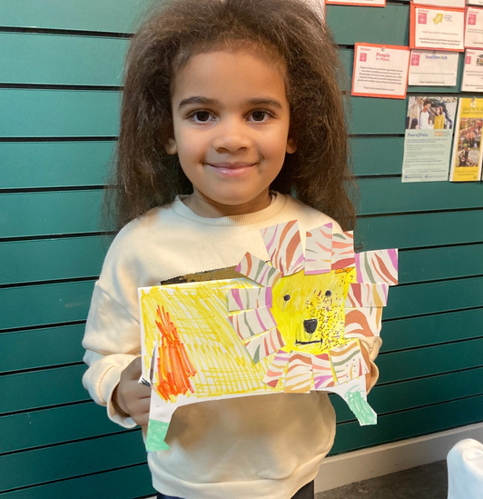
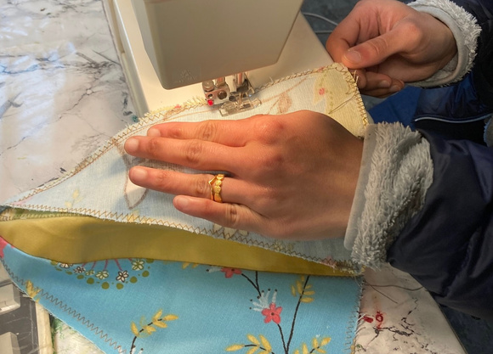
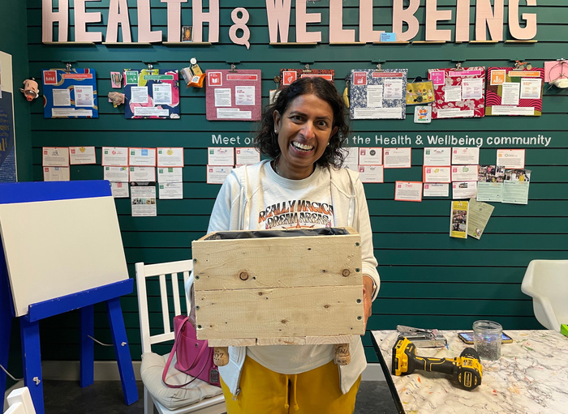


Community action
Creating the strong roots for a resilient community
Royal Borough of Windsor & Maidenhead Climate Partnership Conference
9 October 2024
member of the

Slide 2

What is the overarching problem/s we are faced with?

Slide 3
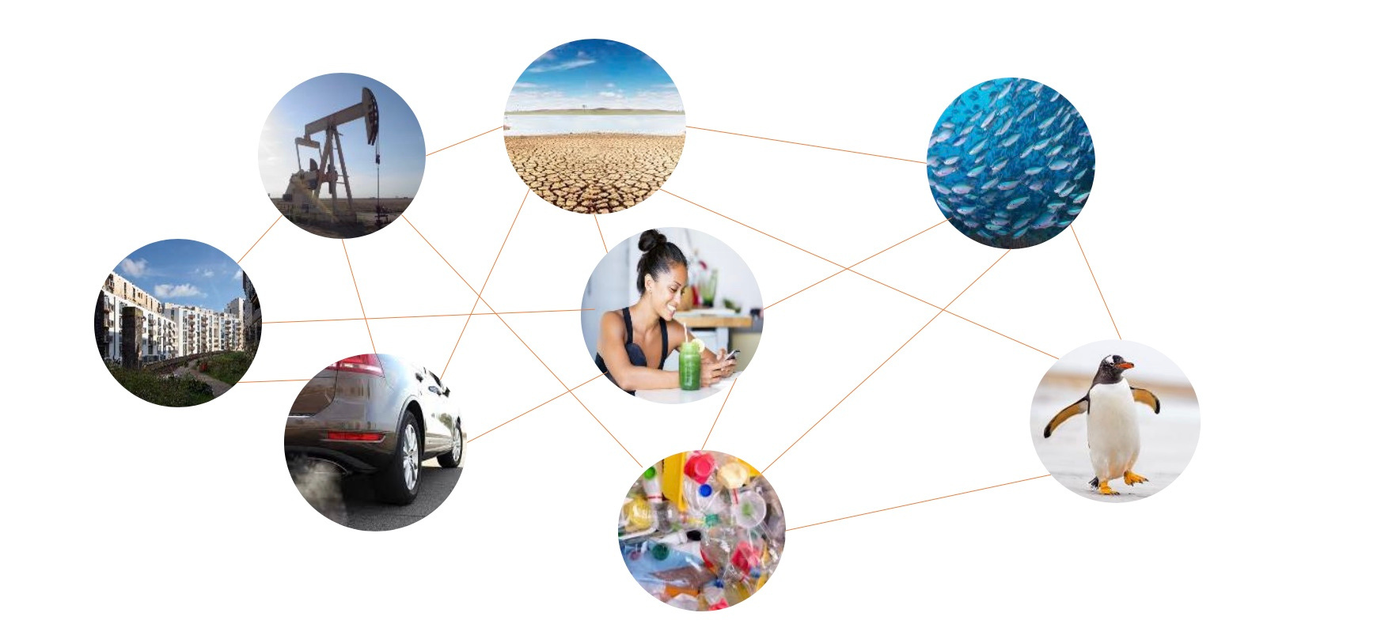
We have built the Green Skills Library so that we can RETHINK how we interact with one another without leaving anything or anyone out.

Slide 4
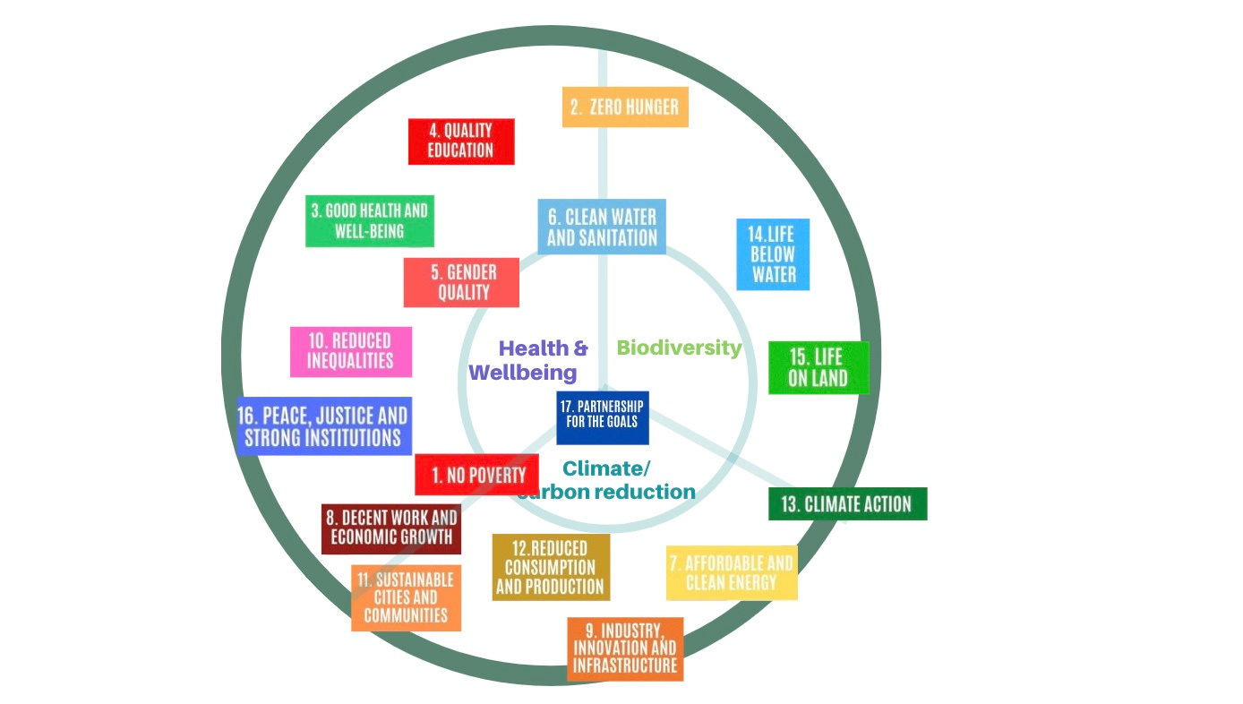
Working with OnePlanet, we have integrated the UN SDGs into the work we do.
  Operating within the framework of the UN Sustainable Development Goals, the Green Skills Library create connections among businesses, communities, and residents to share resources like materials, tools, and expertise
  We use donated materials to educate on sustainable practices, such as composting, craftwork and sewing.

Slide 5
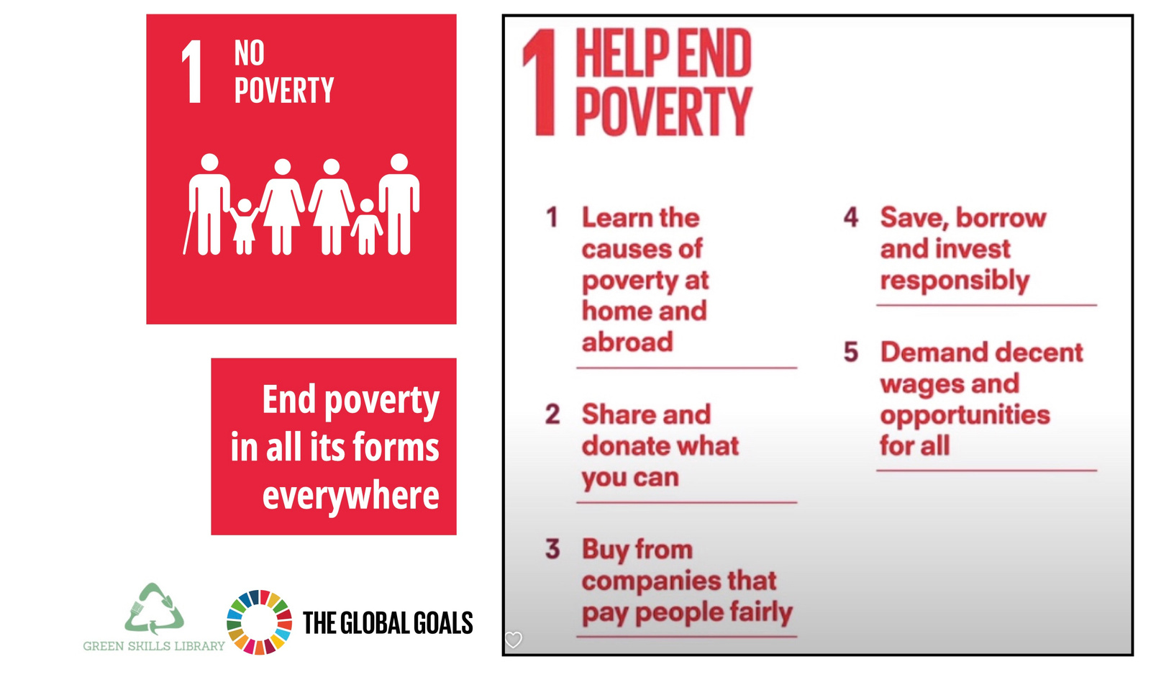




We have each of the UN SDGs in our hub, and link local organisations to those SDGs
  When we are working with large communities like OneMaidenhead, for example, we are able to bring these groups to the residents’ attention.

Slide 6
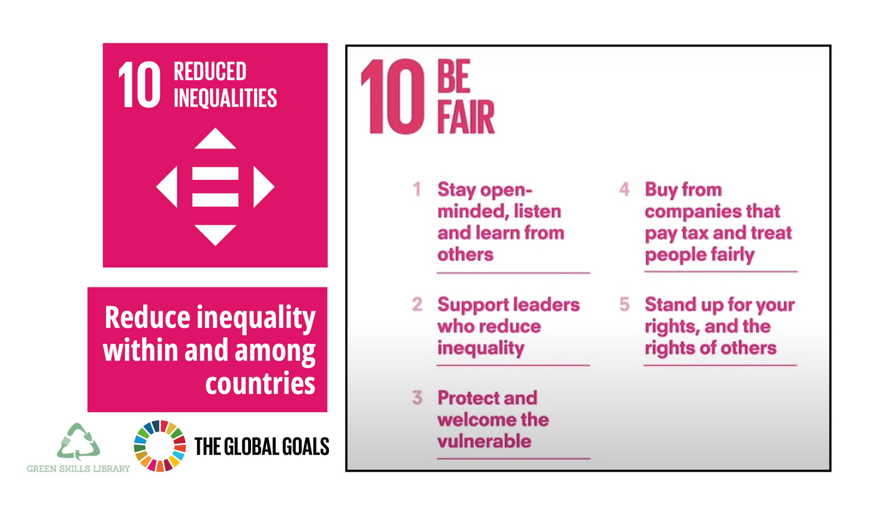
We have seen a significant improvement in the disposition of those with whom we interact
  We believe it comes down to people’s need to belong, and their desire to be able to feel valued, and make a difference
  Together with L&G Tempo and RBWM community team, we delivered an impact strategy aimed at those who need help the most within Maidenhead

Slide 7
We are creating a OneNeighbourhood team to deliver interventions can help the most under-represented in our community
  These will include, for example, a Chatty Cafe scheme, Low Sensory Hours, Apprenticeship Scheme for Young Job Seekers, Supported Employment & Volunteering, and a Community Podcast
  To flesh out one example, for the Apprenticeship scheme for young job seekers, we are learning from other partners (e.g. Inspire2Ignite) , and are connecting with businesses who want our young people (e.g. OVO). We will host networking events and training workshops
  We will be gathering all information together under the OnePlanet framework so it is accessible for all

Slide 8
We are indebted to our supporters and would be delighted to work with any other likeminded organisations
  RBWM Council
  RBWM NHS Innovation Fund
  Leo Lion Foundation
  A Hoppy Place
  Inspirations
  Brewers
  Ecoally
  Off the Tap
  Legal & General Tempo
  Waltham Place Farm
  OnePlanet
  Berkshire Community Foundation
  OneMaidenhead, getliving, Action Funder
  CSK Architects
  Travis Perkins Builders Merchants
  National Lottery Community Fund
  Anthropy at the Eden Project, Cornwall

