Slide 1
Health Effects of Climate Change in the UK and local action
Georgia Careless – Public Health Programme Officer

Slide 2
The Council declared a “Climate Emergency” in 2019 with the aspiration to drive greener change and slow global heating.
Set a target of net zero carbon emissions in the borough by 2050 at the latest, in line with the Government policy, and a science based trajectory
Notes:
Four themes – Energy, Natural Environment, Circular Economy and Transport
Detailed Action Plans against each theme

Slide 3
There is substantial and growing evidence of the effects of climate change on health in the UK.
This report has reviewed the evidence of what climate change means for the UK population.
Harms to health can be effectively reduced through multi-sectoral action.

Slide 4
Many adverse health impacts are avoidable with climate change mitigation and preventable at lower warming levels through effective adaptation

Slide 5
Local Picture
The greatest opportunity for health benefits in the context of climate change comes from the potential to align health goals with the UK’s decarbonisation agenda.
This is also true within local landscapes. If health considerations are embedded in local environment strategies there is the potential to generate a range of health benefits, particularly through:
Air quality
Food
Housing
Transport
Green space
Improved mental and physical health
Reducing health inequalities
Harms to health can be effectively reduced through multi-sectoral action.
The Building Blocks of Health
The Health Foundation, July 2022

Slide 6
Health inequalities and climate change
The health risks of climate change will not be distributed equally across the UK or across generations.
Those less able to control their environment, adapt their behaviours, or respond to new risks will be particularly vulnerable to climate change and includes:
children
people with disabilities
people experiencing homelessness
people living in settings such as prisons, schools and social care
older adults (over 65 years)
people with pre-existing health conditions
Current working age adults will be in their retirement years and those who will be adults in the 2050s to 2080s face the greatest need for adaptation.

Slide 7
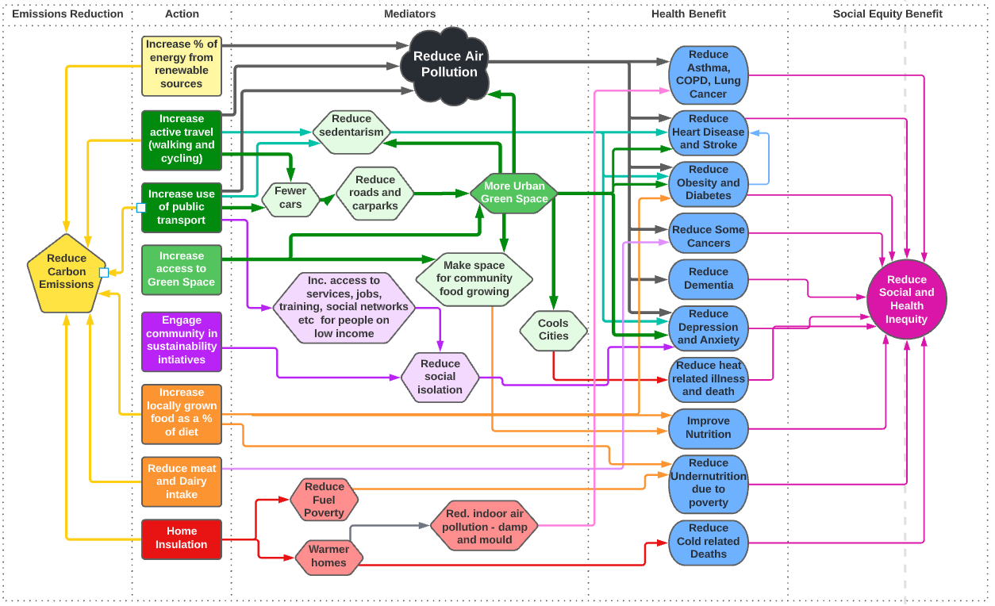

Slide 8
Heat Related Health Risks
Rising temperatures, coupled with more frequent and intense heatwaves, will increase heat-related health risks.
Certain people will be more vulnerable to heat related illness and potentially find resilience harder, e.g. an older person resident in a care home.
What are we doing locally?
Public Health disseminate key public health messages in different languages to support public awareness and advice during extreme weather events.
Public Health also support the implementation of the local heatwave plan which runs from 1 June to 15 September each year.

Slide 9
Indoor Environment and Health
We spend about 90% of our time indoors, so this is an important environment that we are exposed to.
Making homes more energy-efficient is therefore vital for mitigating the impacts of climate change and as a means of promoting healthy indoor environmental quality.
What is happening locally?
Improving energy efficiency domestic and private properties.
Signposting residents to available grants.
Working together to provide information and data about residents living in higher levels of fuel poverty to inform targeted support.

Slide 10
Flooding, mental health & health protection
Climate change is making more people vulnerable to flooding, including those in areas that were not previously at risk.
Large scale floods in the Borough in January with multiple communities affected
Flooding not only threatens lives but has further negative impacts on health, well-being, the economy, and the environment.
Can lead to long-term and severe effects on mental health.
What is happening locally?
Refresh of the RBWM Local Flood Risk Management Strategy will include public health evidence.
Use of a suite of national resources to support public mental health and resilience post flooding events.
Provision of advice and information, with a view to promoting the preparation of appropriate local health protection arrangements to residential and business properties during flooding.

Slide 11
Air Quality and Health
Poor air quality is one of the greatest environmental risks to health with negative impacts such as cardiovascular and respiratory diseases, and increased risk of mortality.
The main causes of poor air quality in the UK are currently emissions from domestic activity, industrial activity, power generation, transport and agriculture.
What is happening locally?
Public Health are promoting local access and use of green spaces for travel and leisure.
Public Health are commissioning cross-department projects to support active travel e.g. Healthy Streets & Street Tag ensuring there is focus on family and multi-generational use.
Public Health have input health evidence and data to local cycling and walking infrastructure plans.

Slide 12
Wildfires
Public Health input to local heatwave plan and ensured extreme heat is on the local risk register.
Consideration of extreme heat in RBWM managed nature sites to limit risk of wildfires.
Drought & Food Security
Host the RBWM Rural Forum as an avenue to develop relationships with local food producers and farmers.
Develop understanding of food insecurity and support community projects to reduce this.
Infectious Disease, Allergies & Vector-Borne Diseases
Attending UKHSA incident meetings.
Support NHS treatment offers by Health Protection Colleagues proactively completing review of epidemiology and local surveillance data.
Net Zero & Health
Embedding the Sustainable Procurement checklist for Public Health commissioned services re-procurement.
Offering council staff and members education about climate change and health, e.g. through Carbon Literacy Training.

Slide 13
What are the next steps?
Ensure that Public Health & Climate and Sustainable priorities are aligned and support health co-benefits going forwards
We hope to ensure Public Health priorities are encompassed within Climate Partnership work going forward.
Refresh of the Health & Wellbeing Strategy to encompass and be aligned with Climate & Sustainability Priorities.
Refresh the RBWM Environment & Climate Strategy to embed public health priorities.

