Slide 1
The National Energy Foundation
BETTER HOUSING BETTER HEALTH
The Warmth And Wellbeing Service
Notes:
Introduction
Good morning everyone, thank you for having me here today. My name is ?, and I work for the National Energy Foundation, a charity that runs our fuel poverty project, Better Housing Better Health.
So that’s a brief summary of us! What I’m going to do today is talk to you about fuel poverty –

Slide 2
CONTENTS
A brief overview of NEF/BHBH
Our fuel poverty service – Better Housing Better Health (BHBH)
Support and interventions
Contact us – how to refer
Notes:
In this session I am going to talk to you about our fuel poverty service, Better Housing Better Health, what we can do to help and how to refer residents in to us
If you have any questions at any point, please just let me know. There’s no need to wait until the end.

Slide 3
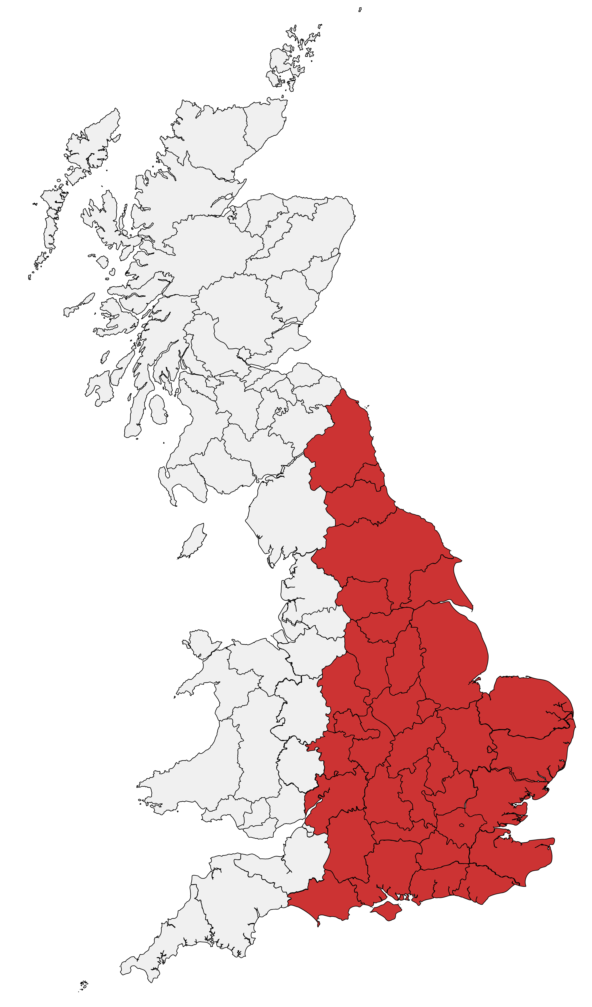
WHERE WE OPERATE
Bedfordshire, Berkshire, Buckinghamshire, Cambridgeshire, County Durham, Derbyshire, Dorset, East Sussex, Essex, Gloucestershire, Hampshire, Hertfordshire,
Isle of Wight, Kent, Leicestershire, Lincolnshire, London, Luton, Milton Keynes, Norfolk, Northamptonshire,
Northumberland, Nottinghamshire, Oxfordshire, Staffordshire, Suffolk, Surrey, Tyne & Wear, Warwickshire,
West Midlands, West Sussex, Wiltshire, Worcestershire, Yorkshire
Notes:
We have been offering our service for over 10 years now, and it started in Oxfordshire with a basic helpline. The advice we could offer was mainly behavioural however we quickly realised just how important this advice was. From here our project grew and grew, and we secured more funding to be able to offer more financial and practical support.
Now, just over ten years on, we cover most of the counties in England.
The counties that we currently cover are in red on the map (Bedfordshire, Berkshire, Buckinghamshire, Cambridgeshire, County Durham, Derbyshire, Dorset, East Sussex, Essex, Gloucestershire, Hampshire, Hertfordshire, Isle of Wight, Kent, Leicestershire, Lincolnshire, London, Luton, Milton Keynes, Norfolk, Northamptonshire, Northumberland, Nottinghamshire, Oxfordshire, Staffordshire, Suffolk, Surrey, Tyne & Wear, Warwickshire, West Midlands, West Sussex, Wiltshire, Worcestershire, Yorkshire)
So that’s a brief summary of us as a charity! What I’m going to do today is talk to you about fuel poverty and how we can support the people you work with –
Next slide

Slide 4
HOW CAN WE HELP?
Energy saving support
Free home energy visits
Grant funding towards energy measures
Grant funding towards energy bills/debt
Other interventions/referrals
Notes:
As you can see from this list, there are numerous way we can support residents. When a resident is first referred to us, one of our trained Project Officers will first carry out a Warm and Well assessment to assess the individual’s situation. We ask quite a lot of indepth questions about their financial situation, dependants, health conditions etc. Once we have the information we need, we are able to suggest the best next steps. I'll gothrough some of the most common interventions with you now

Slide 5
COMMON INTERVENTIONS
General energy advice
Helping with understanding bills and usage, switching tariff and supplier
Priority Services Register
Support from Network Operators & suppliers available to those reliant on electricity for medical / mobility needs or those requiring extra help​
Fire & Rescue Visits
Other local support services
Notes:
Some of the common services that we offer at Better Housing Better Health include:
General energy advice ​
Understanding bills, usage and standing charges​
We can advise on switching tariff or supplier – unfortunately, we can no longer save £300 a year by switching supplier but if residents want to know if it's best to stay on a variable tariff or get onto a fixed tariff, or if they're not happy with the customer service from their supplier and want to know what their options are we can help them with this​
We can also help people understand the energy efficiency of their property – including where the heat is being lost and how to increase their energy efficiency​
​
Adding residents to the Priority Services Register​
The Priority Services Register is a free support service available from Network Operators and suppliers to those reliant on electricity for medical or mobility needs (for example if they have a stair lift, ventilator or refrigerated medicines) but also for anyone with extra support needs (including those with a health condition, of pensionable age, with children under 5 years old, or due to communication needs) and for temporary registration due to life changes (such as post-hospital recovery). It is a useful tool for residents to have running in the background that comes into action when they need it. ​
​
For example, if there is a planned power cut the resident will receive advanced warning along with a direct phone number to call. If a resident has medicine that needs to be kept in the fridge and there is a long interruption to their supply planned, the Priority Services Register is teamed up an organisation who can supply a generator.
​
We can also refer people for Fire and Rescue Home Visits and many other local support services.
Even if it’s not energy related our team will do their best to signpost and support.
Next slide
​

Slide 6
HOME ENERGY VISIT
Home Visit Advisors can offer energy saving advice (inc. behaviour change), help with switching supplier or make sure you’re on the best tariff and help with heating controls.
They can also offer small energy saving measures for free, such as draught proofing or radiator foil.
Issue emergency fuel vouchers and warm packs if appropriate.
Can signpost/refer to other organisations if further help and support is needed.
Notes:
Free home energy visits
A lot of the support we offer can be done over the phone. Our indepth Warm and Well Assessment means that we can help many people without seeing them face to face. Sometimes however, we understand that a resident will benefit from a Home Energy Visit. We have our own Home Energy Advisors who can speak to the resident in their homes and help with a number of different interventions.
During the home visit a trained energy advisor can:
Offer energy saving advice
Help switch energy supplier or tariff
Install small energy saving measures including draught proofing and energy saving light bulbs
Give advice on energy bills and debt
Look into maximising income through benefits
There are many elements of these which we at Better Housing Better Health can do with residents over the phone. The LEAP visits really come into their own for in-house issues such as helping people understand their thermostat, going through switching with the resident in person, issuing the free energy saving measures and debt advice.

Slide 7
GRANTS
FOR ENERGY EFFICIENCY IMPROVEMENTS
ECO4/ECOFlex Funding
Available for insulation measures (loft, walls & floors) and heating system replacements
Boiler funding - ECHO
Emergency Central Heating Obligation scheme – repair or replace
Notes:
At Better Housing Better Health we can help residents access local and national funding. After the initial warm and well assessment we work out which pots of funding residents may be eligible for.
ECO funding – also known as Energy Company Obligation funding – can cover a wide range of measures, including loft insulation, cavity or solid wall insulation and underfloor insulation.
It is mainly for owner-occupiers but insulation measures are available for private tenants.
Emergency boiler scheme – there is additional funding through an emergency boiler scheme available during autumn/winter – it has the same eligibility criteria as ECO funding but if the gas central heating is broken and the resident is in a no-heat situation the boiler will be repaired or replaced for free. This is also unfortunately closed but worth bearing in mind for the autumn and winter months
We are also constantly communicating with local councils to keep up to date with any grants or loans available in each of our areas

Slide 8
GRANTS AND FUNDING
FOR ENERGY BILLS / DEBT
Warm Home Discount
£150 towards winter usage. Most energy providers offer it and is available to those receiving Pension Credit Guarantee Credit or means-tested benefits. Should be received automatically between October and March.
Energy Trust Funds
The main/largest energy providers have funds which can help customers pay off debt. Clients usually need to seek debt advice before applying.
Notes:
The Warm Home Discount is £150 towards your winter usage. Most energy providers offer it and is available to two groups of people. Core Group 1 includes anyone who receives the Guarantee Credit element of Pension Credit. Whilst Core Group 2 includes those in receipt of a means tested benefit or income-capped tax credits. From this year it should be received automatically and there is no need to apply.
Energy Trust Funds: The main energy providers have funds which can help customers pay off energy debt. Clients usually need to seek debt advice before applying, as we’re not a debt advice service this could be their local Citizens Advice or a LEAP referral.

Slide 9
EMERGENCY FUEL VOUCHERS
Referral partners may refer residents to BHBH for a £49 voucher if they are struggling to top up their prepayment meter. The voucher can all go to gas or all to electric or can be split between both.
Notes:
We are currently running an emergency fuel voucher scheme, these will be £49 vouchers available to residents on prepayment meters who are referred to BHBH directly by a referral partner such as yourselves.

Slide 10
MAKING A REFERRAL
0800 107 0044
www.bhbh.org.uk
bhbh@nef.org.uk
@bhbhadvice
Notes:
You may refer residents to us via
Our free to call phone line - 0800 107 0044
Online form at - www.bhbh.org.uk
Or Email at - bhbh@nef.org.uk
We know that you work under tight time constraints, so please don’t worry about trying to find out if someone is eligible for help before referring them. We can do that for you and we are always happy to give you feedback on how we’ve managed to help residents.
Thank you for listening, I hope you have found this useful. Any questions?

Slide 11
Supplier Network
By Mary Bona – Project Manager
ECO4 Flex
Notes:
11

Slide 12
What is supplier network?
Supplier Network delivers support within the energy company obligation (ECO) which is a government energy efficiency scheme in place to help reduce carbon emissions and tackle fuel poverty.
.
Supplier Network is a separate workstream at NEF, the team receive ECO4 flex applications from our approved paying installers on the network, as well as onboarding new installers along with local authority partnerships.
Notes:
12

Slide 13
Eco4 Flex
NEF is currently working with a range of Local Authorities and installers to deliver the ‘Flexible Eligibility’ or ‘Flex’ element of the scheme in their areas. Installers wishing to access funding from ECO Flex to install energy efficiency measures must request a ‘declaration’ from the relevant Local Authority evidencing that the identified households meets the criteria.
Installers find the leads, survey the property, get the completed flex form and evidence and submit to NEF.
NEF check the evidence provided by installers, create a declaration form and submit to LA for signing.
LA check evidence and form, then sign and return to NEF, we then upload into installer folder.
13
Notes:
13

Slide 14
Eligibility Route 1
Evidence Required Most recent year's tax return / P60 documentation for each employment. • Bank statement(s) covering consecutive 3-month period from within the last 3 months prior to when the LA dates and issues the declaration. • Income pension statement (annual or if notified monthly, three from within the last 3 months) • Three monthly payslips or 5 weekly payslips • A P45 from within the last 3 months • Interest made/accrued from all savings, investments and bonds
14
14
Notes:
14

Slide 15
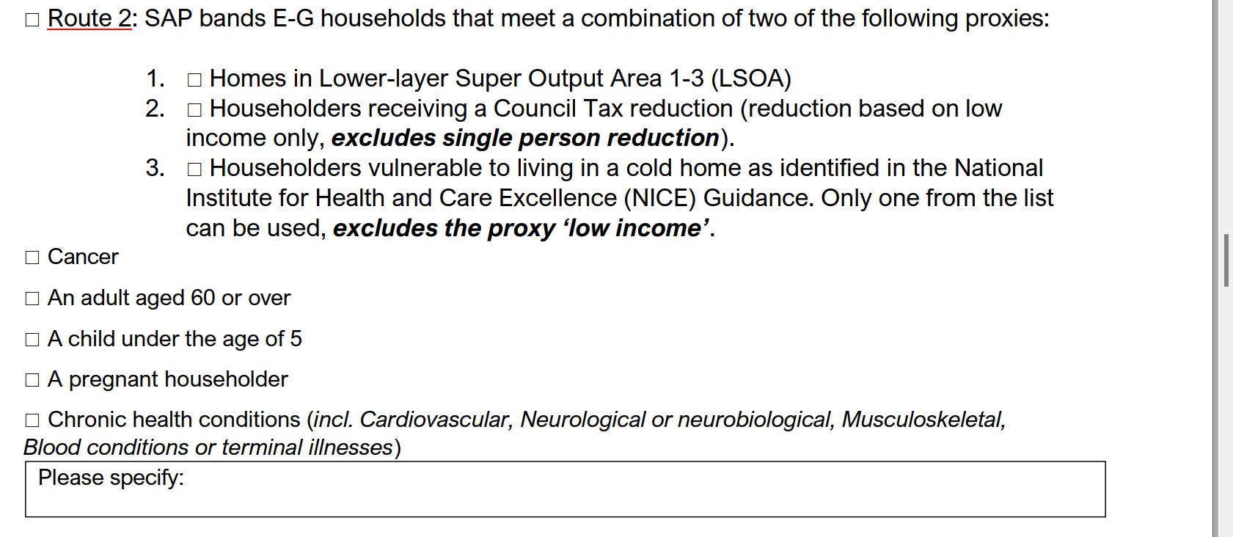
Eligibility route 2
Evidence Required Copy of council tax reduction letter/confirmation e.g. photo, an email, a PDF with name and address clearly shown NHS Referral form filled and signed and stamped by an NHS Professional.

Slide 16
Eligibility Route 3
Evidence Required Signed referral letter from a Doctor, GP or other health professionals with a valid NHS email identifying that a person living at the premises is considered to be vulnerable to the cold and suffers from a health condition as stated in the NICE [National Institute for Health and Care Excellence] guidance: Recommendation 2, for a reason other than their low-income. • An NHS Summary Care Record provided it clearly states that the patient suffers from a health condition as stated in the NICE guidance or receives medication for the condition. The Summary Care Record must be authenticated with the GP practices stamp.

Slide 17
Additional Eligibility Route 4
Evidence Required Any documentation showing eligibility for free school meals due to low-income provided by the Department for Education or from the School • Eligibility Checking Service (ECS)27 www.fsm.education.gov.uk https://www.gov.uk/government/publications/free-school-meals-guidance-for-schools-and-local-authorities
17

Slide 18
Onboarding and declaration Fees
There is a one-off ‘on-boarding’ fee of £500+VAT to join the network, with an annual fee of £100 to be paid at the start of each financial year, effective from 1st April 2024, and a £85+VAT administration fee per declaration issued, for installers ONLY. Local authorities do not pay any sort of fees to partnership with Supplier Network.

Slide 19
Approved Paying Installers
A & D Carbon Solutions
Active Homes Ltd
Agility ECO
All Seasons Interiors
Alto Energy Ltd
Aran Insulation Ltd
Baxter Kelly Ltd
Berks Insulation Ltd
Carbon Rewind Ltd
Carbon Savings Ltd T/A Warmauk
Commercial Improvements Ltd
Direct Savings
InstaGroup Ltd
J & J Crump & Son Ltd.
Marigold Insulation UK Ltd
Max Energy
Midland Smart Energy Limited
Next Energy Solutions Ltd.
Next Recycle Previously Elanworth Ltd.
South Coast Insulation Services
YES Energy Solutions
Dyson Energy Services
Eaga Energy Ltd
ECO SUBS LIMITED
Eco3 Installs Ltd/BNeutral
Ellipse Energy Ltd
Energy Saving Group Ltd
Energy Saviour
Energy Specifics Ltd
Environmental Technical Services
Evolve Home Energy Solutions
Free Eco Funding
Golden Globe Merchants Ltd
Grant Store
Green Deal Centre
Green Home Plans ltd.
Home Efficient Ltd
MK City Group Ltd
NCS Property Maintenance
Network Energy Ltd
Macbrook Gas Ltd.
Zing Energy
Urban Retrofit Projects Ltd
Emerald Green Energy Ltd
Nu-Wey
Origin Energy Service
Park Home Energy
Passion Solutions Ltd
Platinum Park Home Services
Plumb- Line Contracting Limited
Prescription for Wamth
Premier Energy Contractors
RMS Energy Solutions
Saviour Energy Solutions Ltd
Simple Green Energy Ltd
Simply Eco Ltd.
Smart Energy Sense
SO, ECO Ltd
Stellar Energy UK Ltd
Sustain Energy
Thames Valley Insulation
Zoa Energy Solutions
Work Work Ltd
Notes:
19

Slide 20
Suppler Networks Areas
NEF (National Energy Foundation) currently administers ECO Flex on behalf:
Basingstoke and Deane Council
Buckinghamshire Council
Cherwell District Council
Dacorum Council
Hammersmith & Fulham District Council
Hertsmere Borough Council
London Borough of Ealing Council
North Northants Council
Oxford City Council
South Oxfordshire District Council
St Albans City and District Council
Three Rivers District Council
Vale of Whitehorse District Council
Watford Borough Council
West Oxfordshire District Council
West Northants Council
Winchester City Council
London Borough of Hillingdon
Royal Borough of Windsor and Maidenhead
West Sussex
Welwyn Hatfield Borough Council
East Hertfordshire Council
Essex County Council
Stevenage Borough Council

Slide 21
Image SLide
WHO WORKS ON SUPPLIER NETWORK?
Mary Bona – Project Manager: Mary.Bona@nef.org.uk
Nicole Wong –Project Officer: Nicole.Wong@nef.org.uk
Charlotte Roberts – Administrator: Charlotte.Roberts@nef.org.uk
21
Notes:
21

Slide 22
SUPPLIER NETWORK Contact details
01908 699992
suppliernetwork@nef.org.uk
22
Notes:
22

Slide 23
Thank you!
Notes:
23

